Slide 2
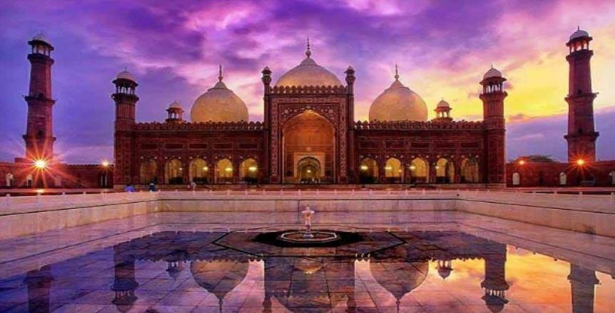
LAHORE

Slide 3
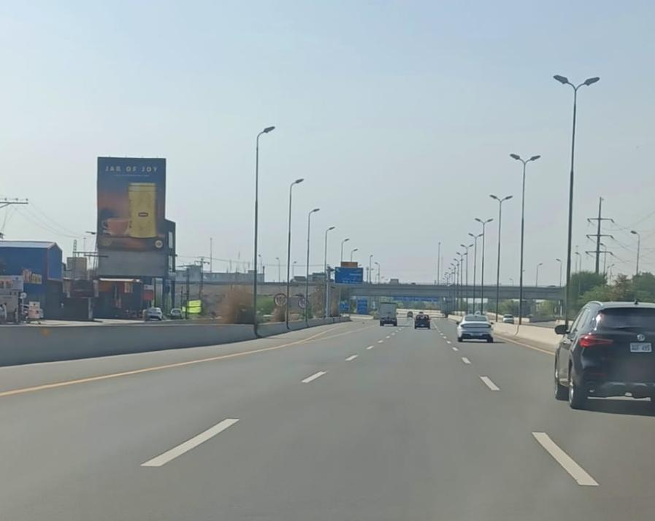
Ring Road DHA Near Askari 11 Cantt
FTCF: Airport, Askari 11, Stat life society, Going Toward: DHA Prism, Lake city
30ft x 40ft

Slide 4
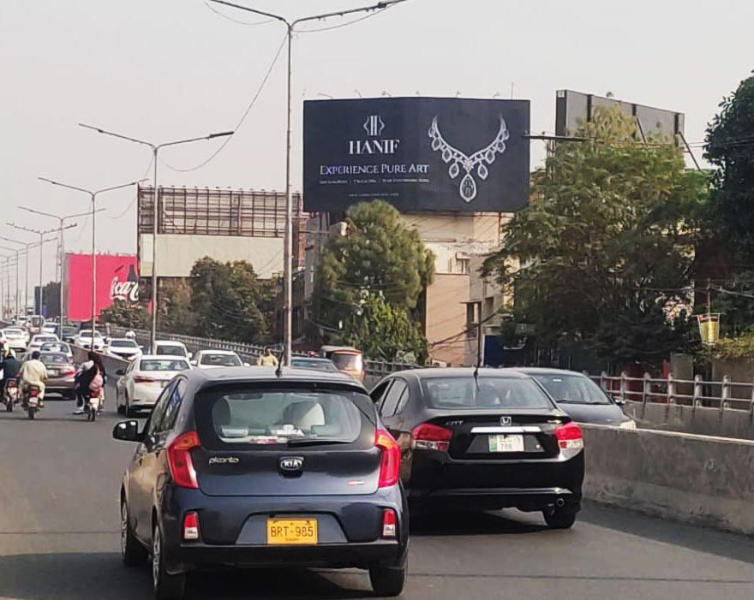
Jinnah Flyover Fc Firdous Market
FTCF: Gulberg, MM Alam Road Towards: Cavalry Ground, DHA Cantt, Walton Road
50ft x 25ft

Slide 5
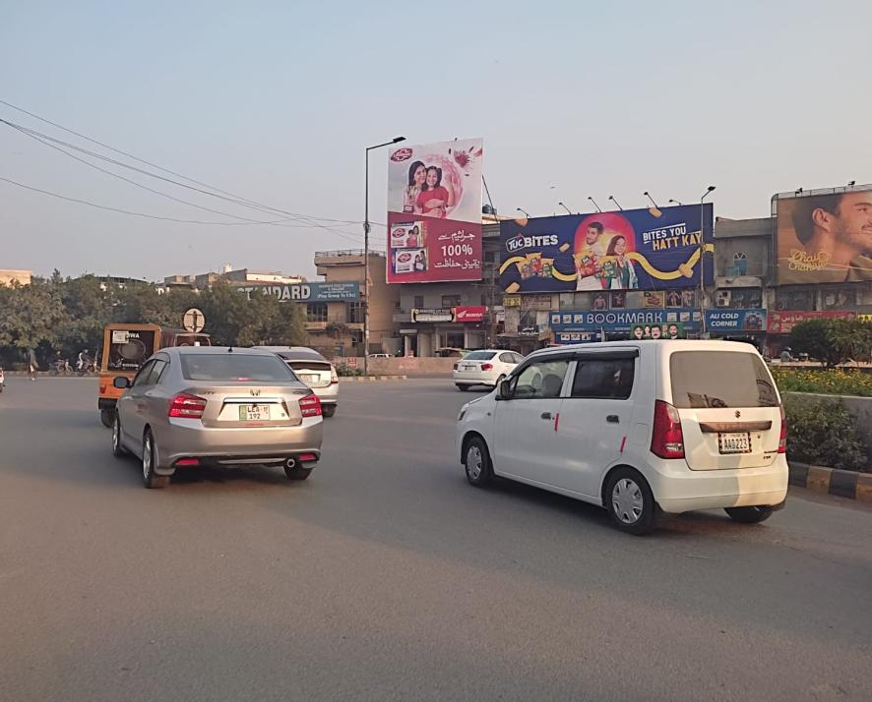
Kareem Block Market Roundabout Iqbal Town
FTCF: Multan Road, Iqbal Town All Phases Towards: Moon Market, Canal Road, Kareem Block Market
30ft x 40ft

Slide 6
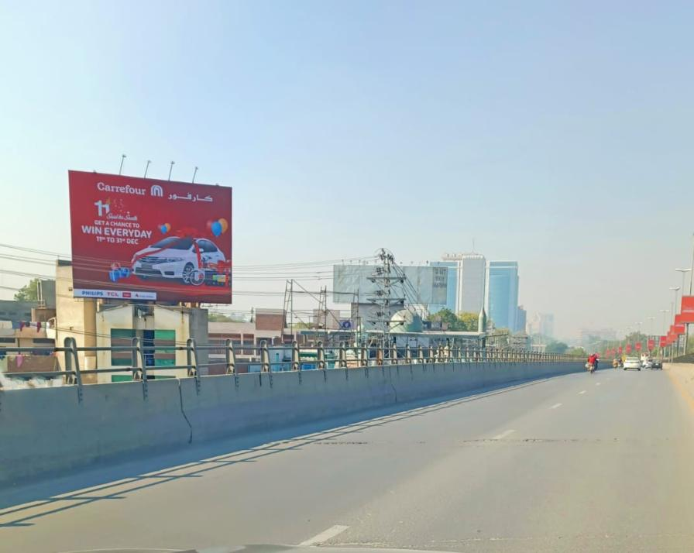
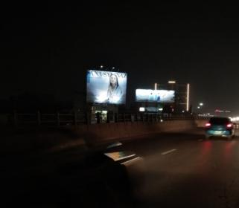
Sherpao Bridge Fc Cantt
Traffic Coming From Cantt,DHA Going Towards Sadiq Trad Center Gulberg Jail Road
40ft x 30ft

Slide 7
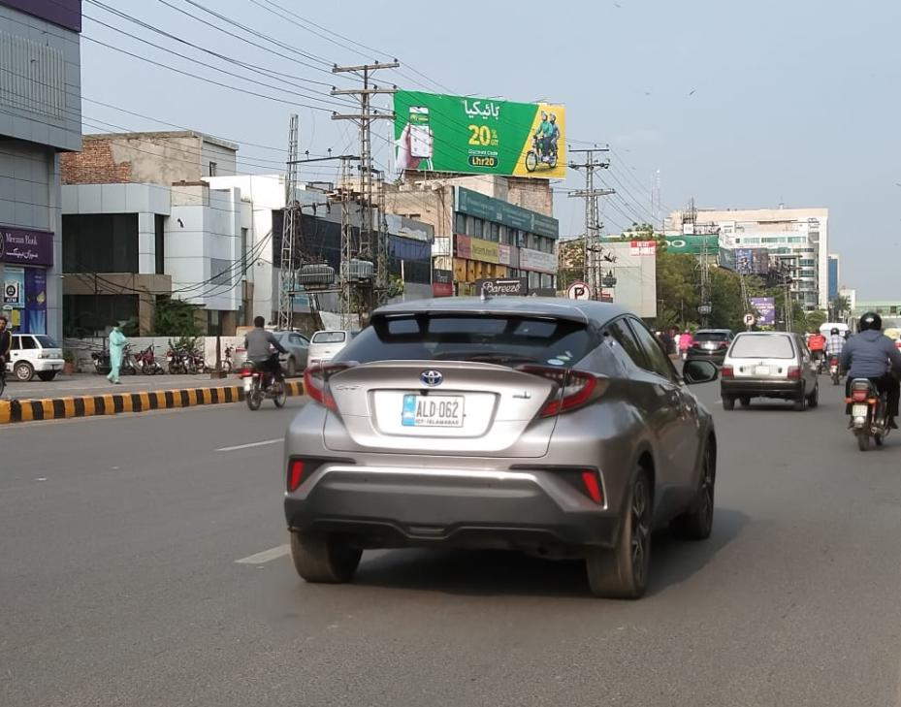
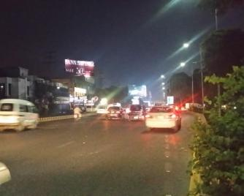
Main Blvrd Gulberg Before Pace
FTCF: Kalma Chowk ,Liberty Roundabout,Model Town, Going Toward Main Market,Saddiq Trad Center ,Jail Road,Gulberg,Cantt
60ft x 20ft

Slide 8
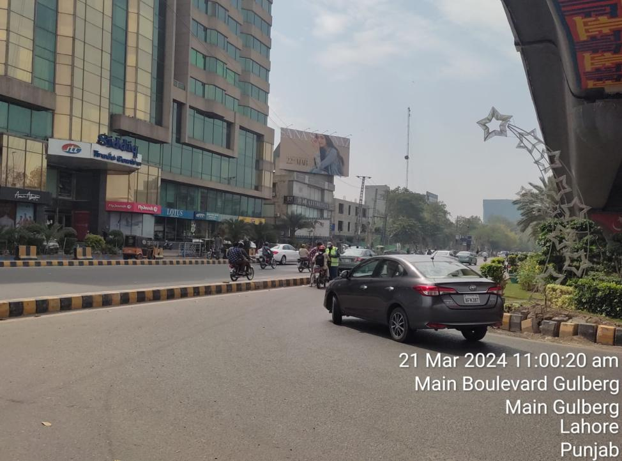
Saddiq Trade Center U-Turn Main Blrd Gulberg Fc Jail Road
FTCF: Jail Road, Sherpao Bridge Cantt, Toward: Liberty Roundabout, Kalma Chowk Center Point Gulberg All Phases
25ft x 50ft

Slide 9
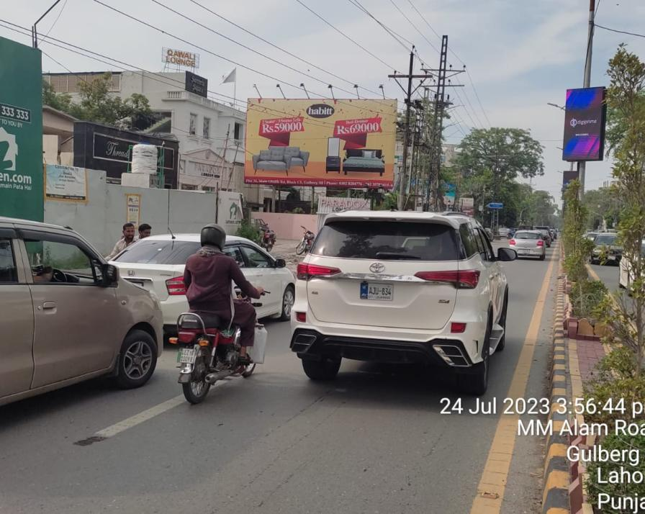

MM Alam Road Gulberg
FTCF: Hussain Chowk, Liberty Market, Jinnah Flyover Going Toward: Mini Market, Main Market, Gulberg Main Blvrd
20x35

Slide 10
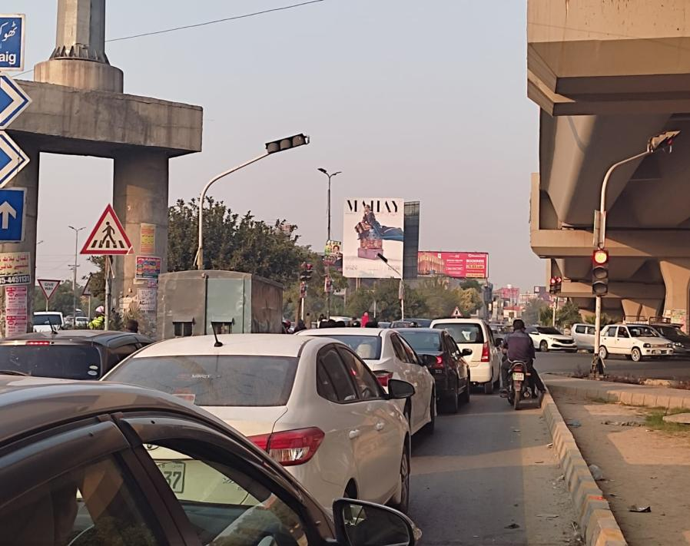
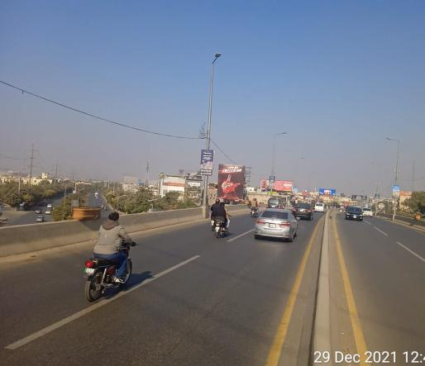
Shakut Khanam Chowk (Flyover)
Signal View
FTCF: UCP University, Valencia Town,Going Towards: Wapda Town, Allah Hoo Roundabout,Thokar , Imporium Mall
Flyover View
30x40

Slide 11
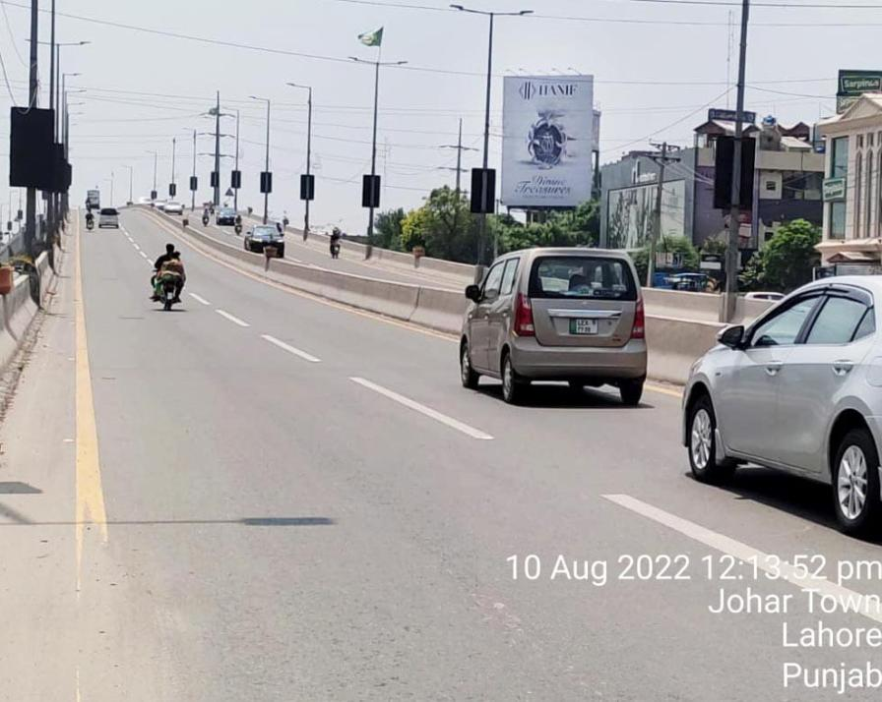
Shukat Khanam Flyover
FTCF: Allah Hoo Roundabout, Wapda Town, Thokar, Going Towards:Ucp University, Valancia Town
30ft x 40ft

Slide 12
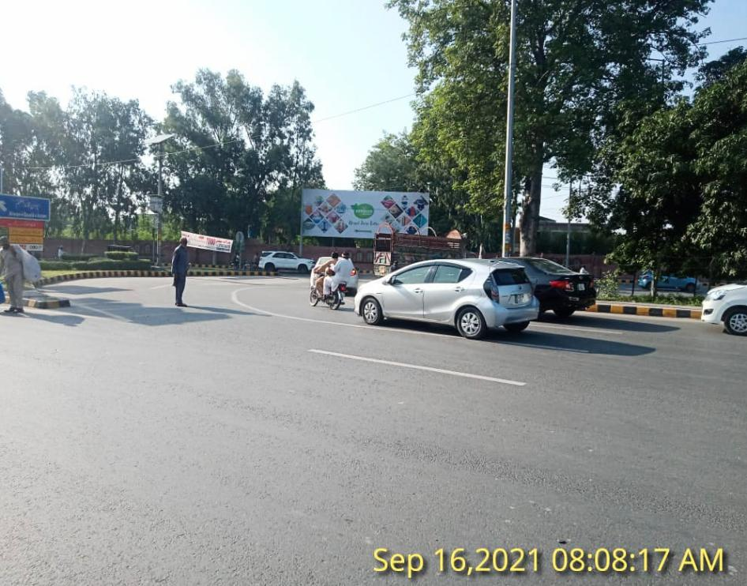
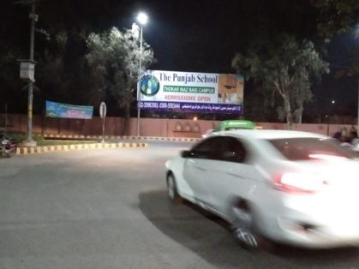
Judicial Colony Thokar Niaz Beg U-Turn
FTCF: Main Canal Road Towards: Thokar Niaz Baig,Canal Road Bahria,EME, Johar Town
15ft x 40ft

