Slide 1



Slide 2
Lahore

Slide 3

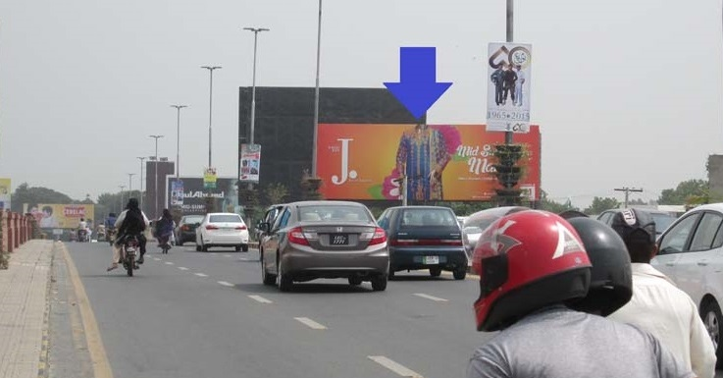
Mian Mir Bridge Fortress (Facing Mall)
Size: 60 x 20
IDX: 791925
Location: Traffic Coming From Lower Mall Towards Square Mall Fortress Stadium Lahore cantt.
Available Date: 24-08-2024

Slide 4
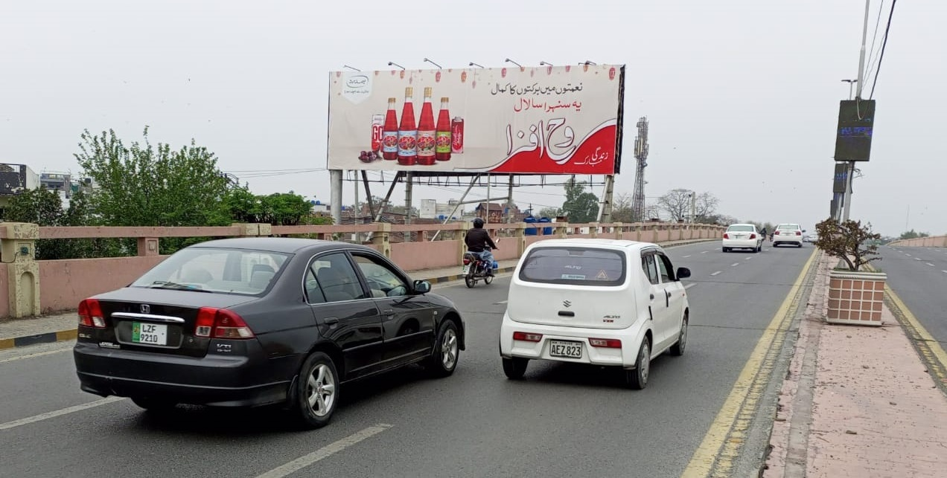
Mian Mir Bridge Fortress (Facing Cantt)
Size: 60 x 20
IDX: 791924
Location: Facing Traffic Coming From Fortress Cantt Towards Mall road Lahore.
Available Date: Available

Slide 5
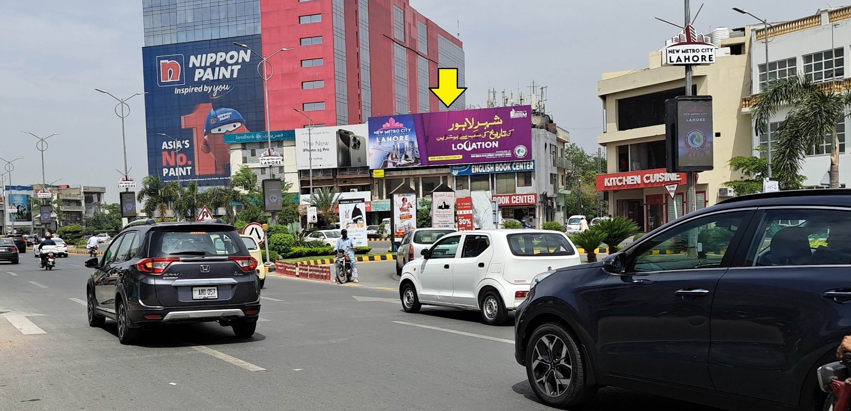
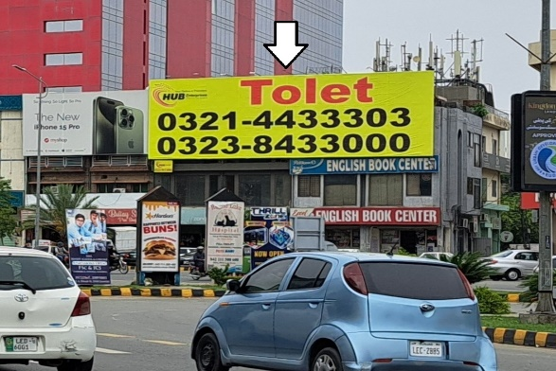
Lalik Jan Chowk DHA Phase 2
Haly Tower, Imtiaz Store
Size: 60 x 20
Location: Facing Traffic Coming From Lums, Wateen Chowk DHA Phase 5 Towards Ghazi Chowk, Masjid Chowk, H Block, Y Block DHA Phase 1.
Available Date: Available

Slide 6
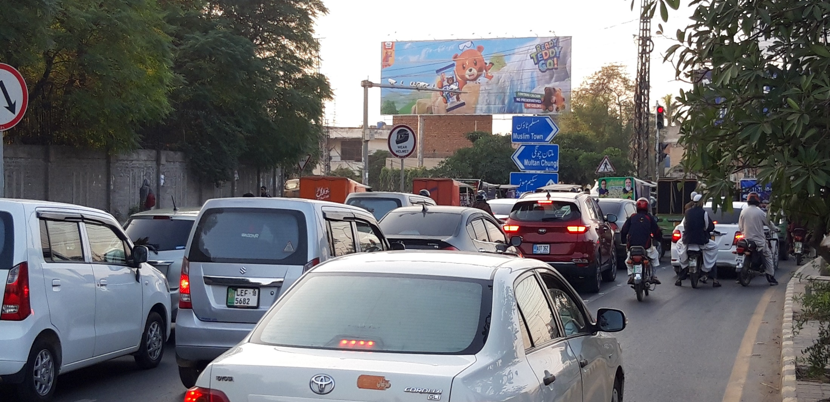
T-Junction Iqbal Town Bhaikewal Morr Signal
Size: 60 x 20
IDX: 792625
Location: Facing Traffic Coming From Campus, Barkat Market towards Iqbal Town, Moon Market.
Available Date: Available

Slide 7
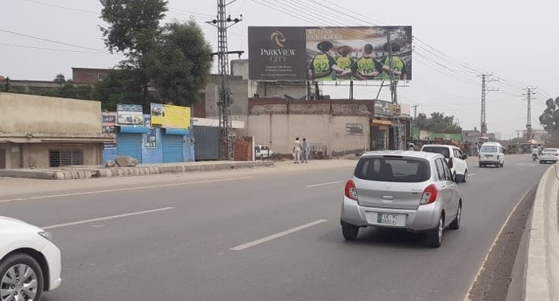
Chung Multan road Lahore
(Near ParkView Society Lahore Entrance)
Size: 60 x 20
Location: Facing Traffic Coming From Multan Towards Parkview Society, EME, Canal road, Thokar Lahore Entrance.
Available Date: 01-09-2024 Ext

Slide 8

Above rates are Exclusive of WHT & GST.
Above Rates are without Skin & Fitting Charges.
We are not responsible for damage of skin in case of Natural Disaster.
Please reconfirm the availability of sites before confirmation
In case of Signboard removed or hide (What's so Ever Reason) Party is bound to pay amount for used Display Period.
100% Payment in Advanced.

Slide 9


Ahsan Ali
0323-8433000
Marketing Manager
Hub Enterprises
Ph : 042-35691991-2
Fax : 042-35691993
Ahsan.hubenterprises@gmail.com

