Slide 1

LAHORE

Slide 2
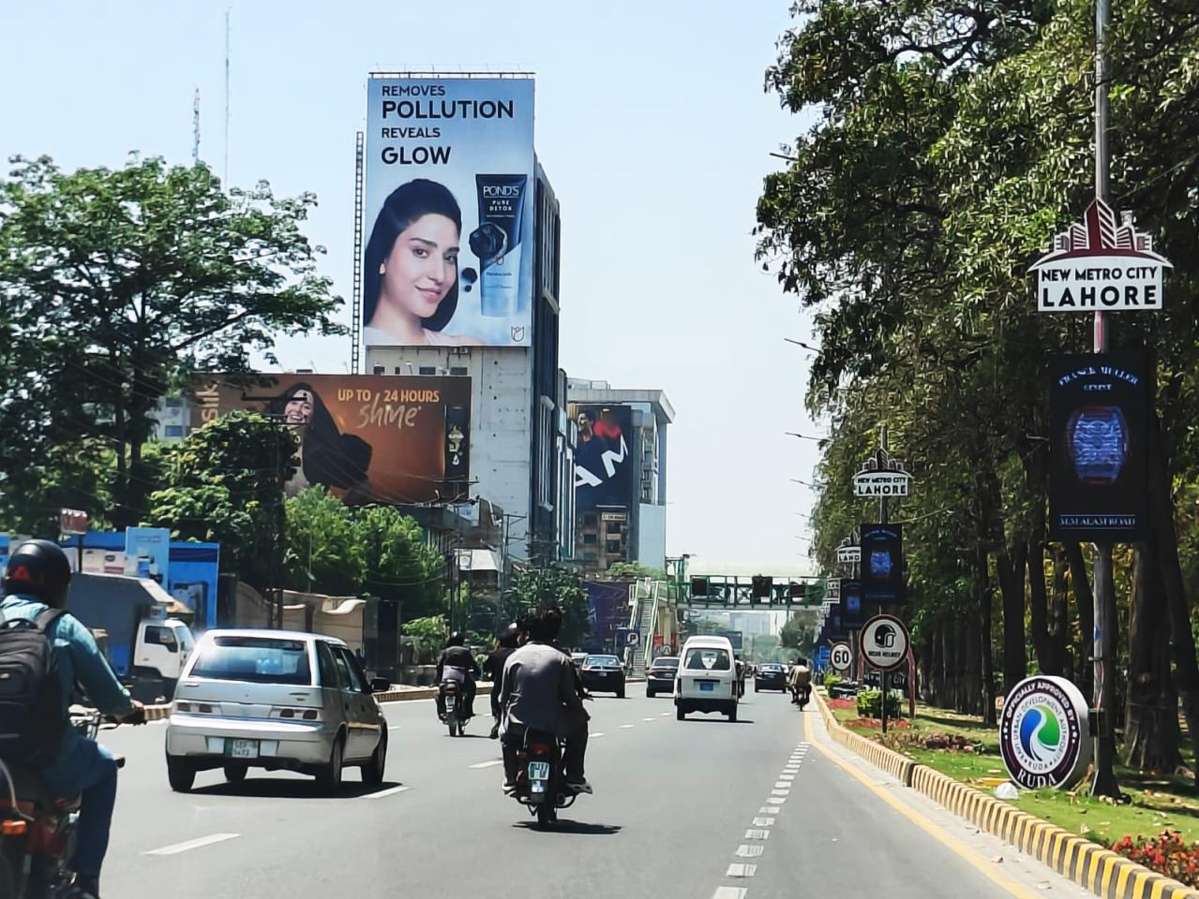
LAHORE
MOVE IDX
799979
Gulberg Main Boulevard, Lahore
Facing Sherpao Bridge, Sadiq Trade Center, Main Market, Mini Market Towards Liberty Market, M M Alam Road, Center Point
Size 60x90

Slide 3
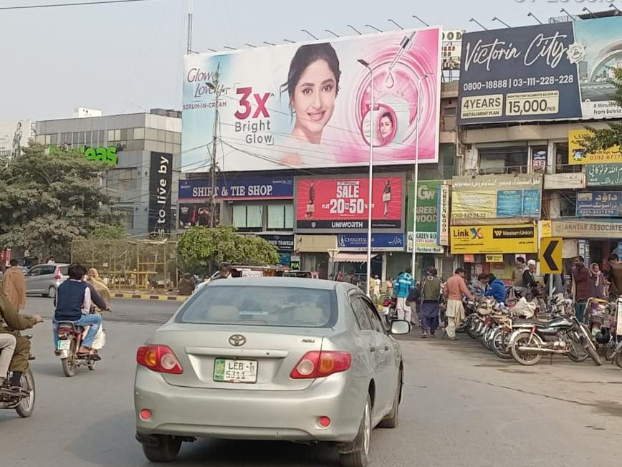
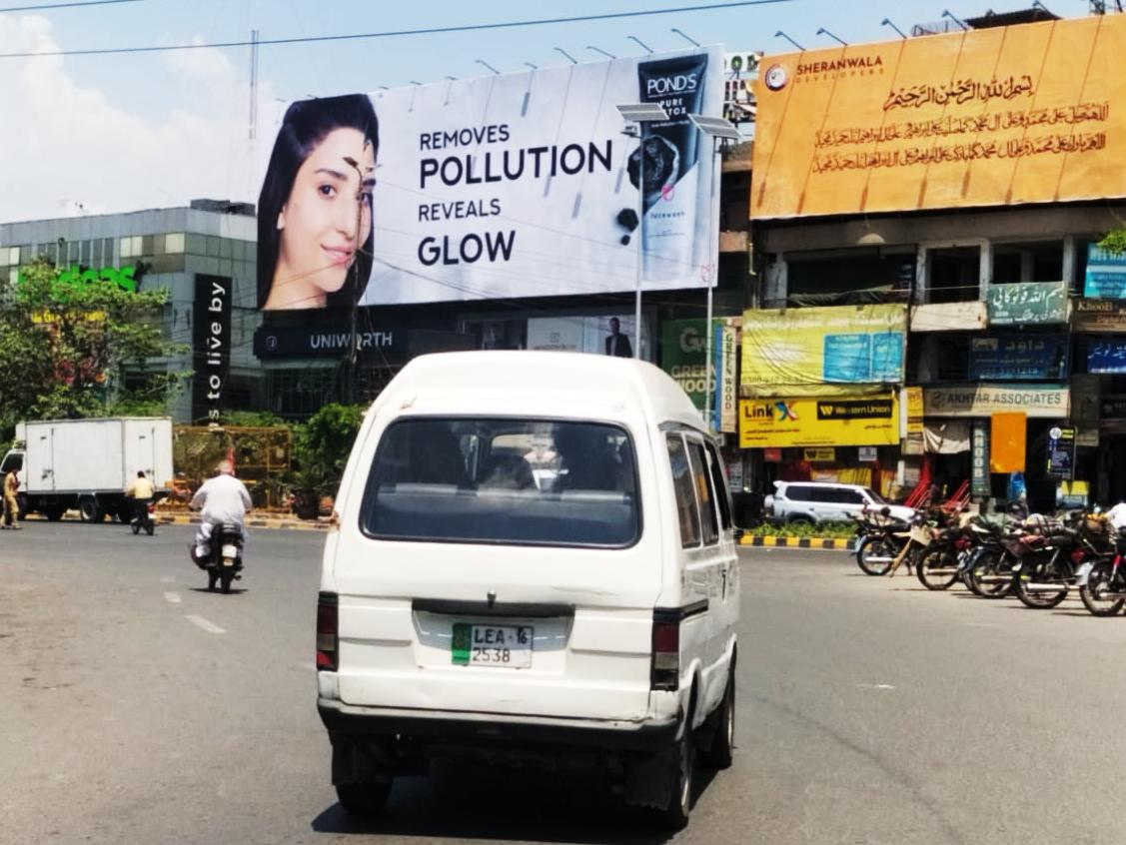
LAHORE
MOVE IDX
792638
Wapda Town Roundabout, Lahore
Facing Wapda Town, Johar Town Towards Shoukat Khanum Chowk
Size 80x30

Slide 4
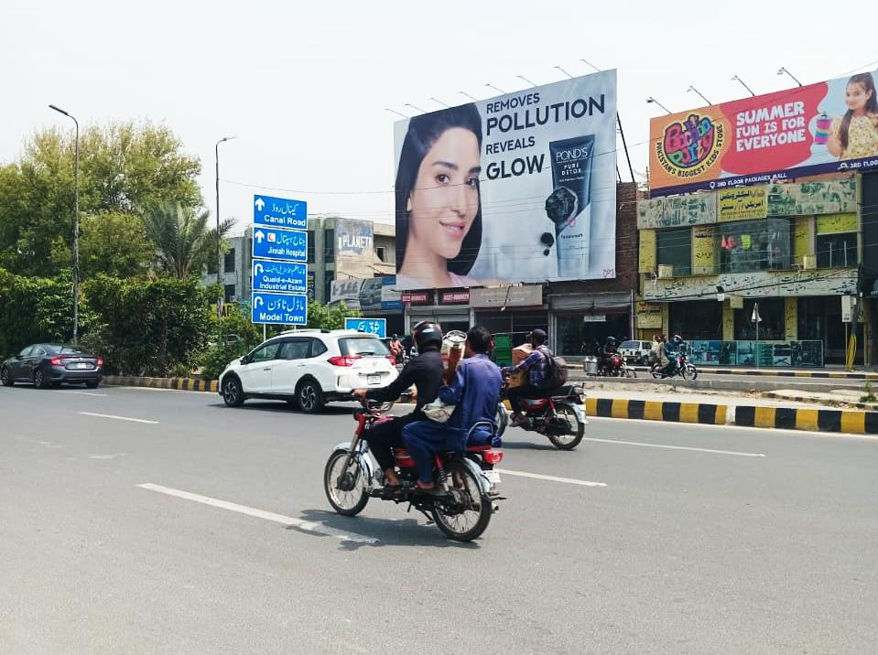
LAHORE
MOVE IDX
792638
Shoque Chowk, Lahore
Facing Allahoo Chowk, Pico Road, Model Town Towards Canal Road, Iqbal Town
Size 60x40

Slide 5
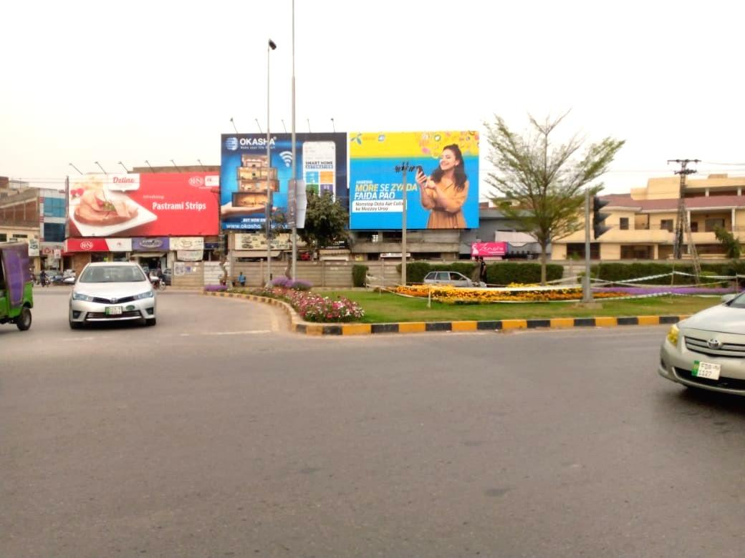
LAHORE
MOVE IDX
800404
Airport Road Jawad Cheema Chowk, Lahore
Facing Mall Road, Haj Terminal Towards Askari X, Airport Road
Size 40x30

