Slide 1

Our Presence In Different Cities

Slide 2
Karachi

Slide 3
Static Media

Slide 4
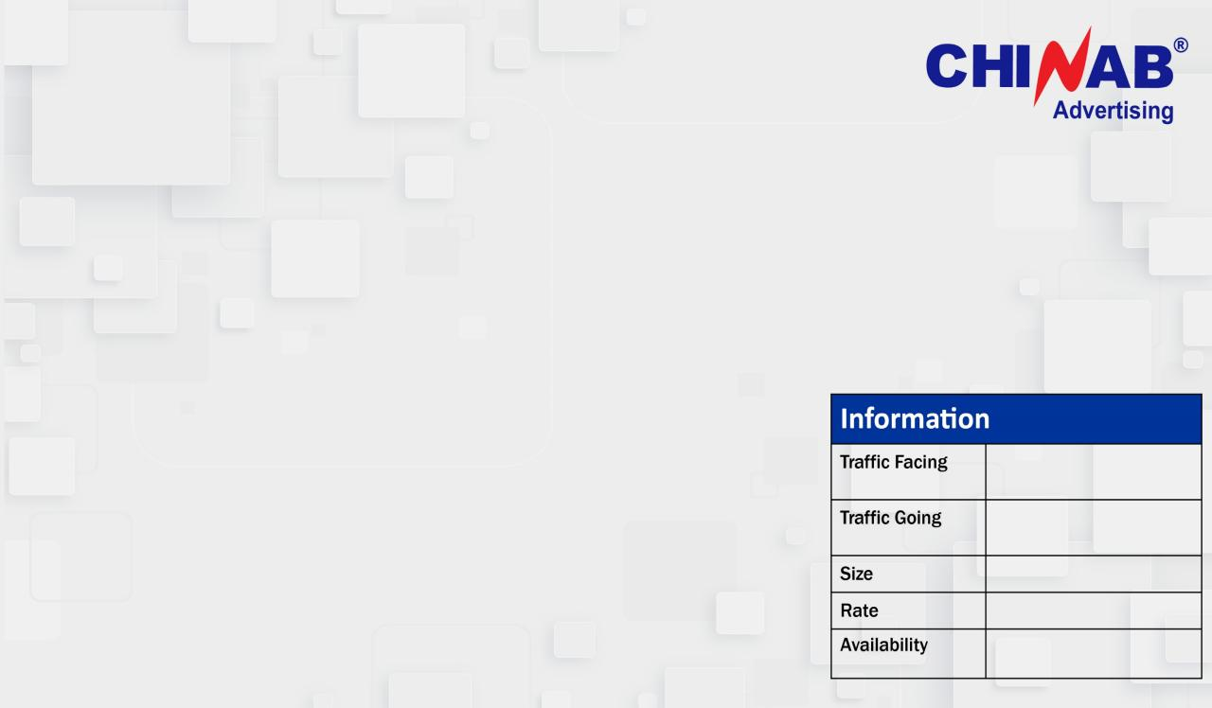
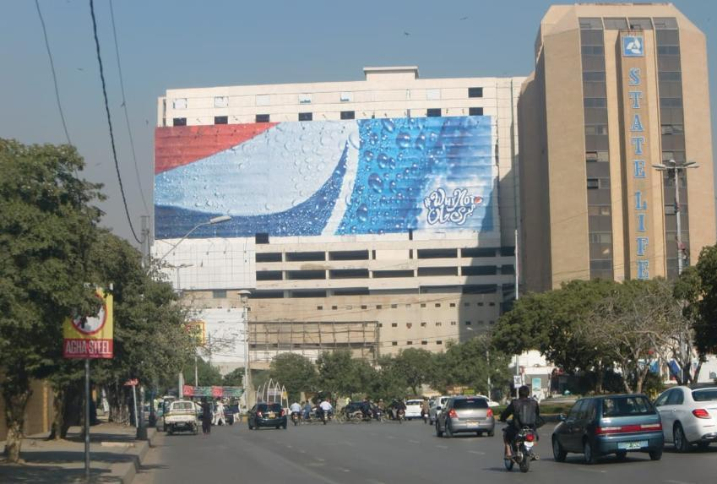
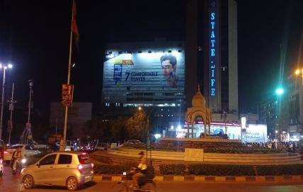
INTERNATIONAL CENTRE (MARRIOT)
Metropole Triangle
/Governor House
Saddar Mobile Market
200x70
5,500,000(with Lights)
24-8-2024(ext)

Slide 5
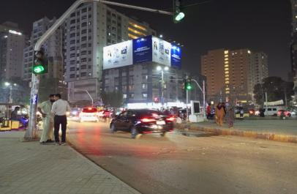
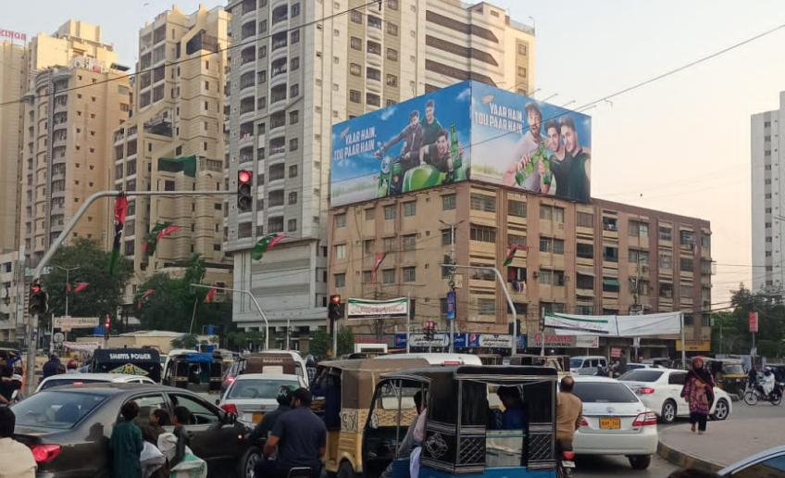
Tariq Road ABL Roundabout Signal
Bahadurabad
Tariq Road
130x30
2.5 million(with Lights)
30-8-2024(extendable)

Slide 6
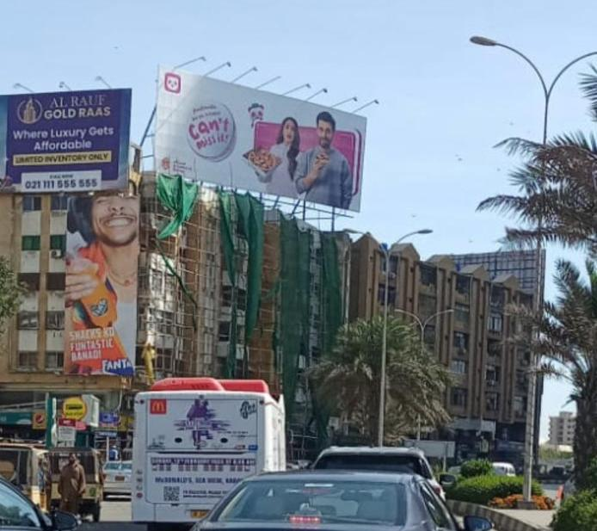
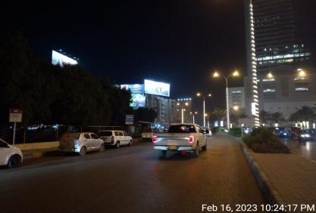
Hyper Star Dolmen Mall Clifton
Hyper Star Round About
DHA\McDonalds
75x30
3,000,000(with Lights)
24-8-2024

Slide 7
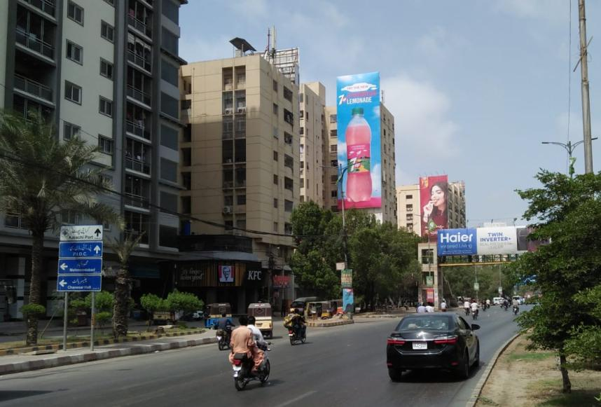
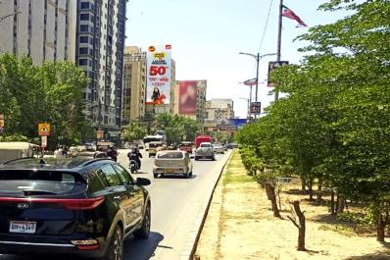
Shah re Faisal Airport to Saddar
Airport
Saddar
30x90
22,00,000
20-8-2024

Slide 8
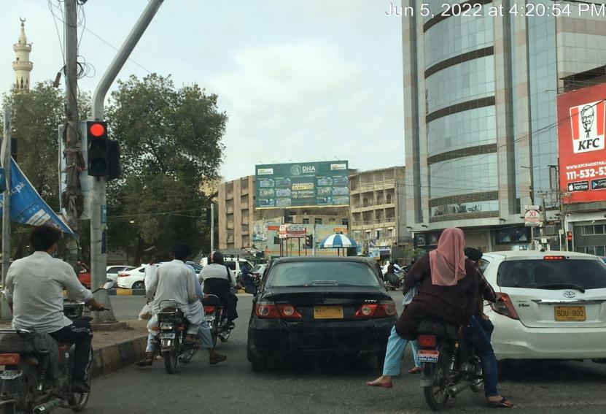
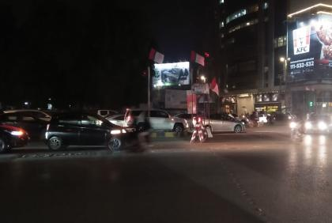
Tariq Road Allah wali Chowrangi Signal (flex)
Allah wali Chowringi
Tariq Road
60x30
1,800,000(with Lights)
20-8-2024

Slide 9
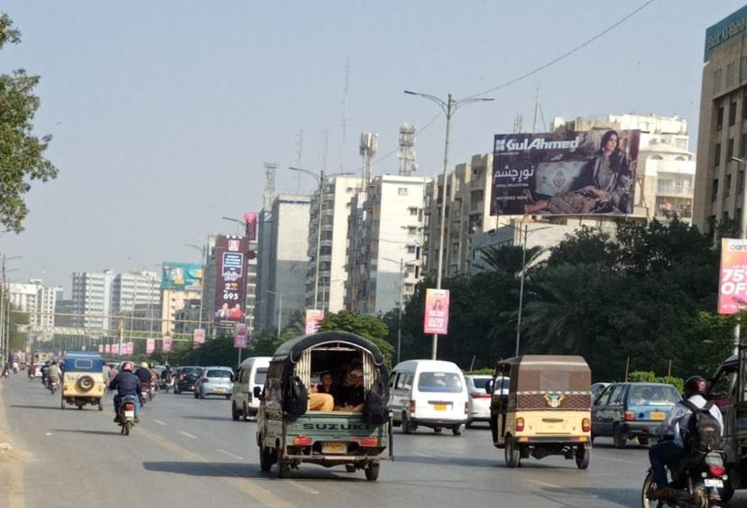
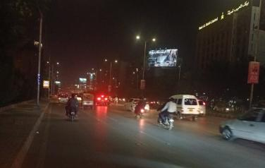
Sadar to Airport Shahr e Faisal (Nursery)
Saddar
Airport
60x30
1,800,000(with Lights)
24-8-2024

Slide 10
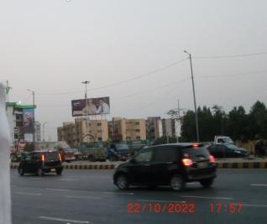
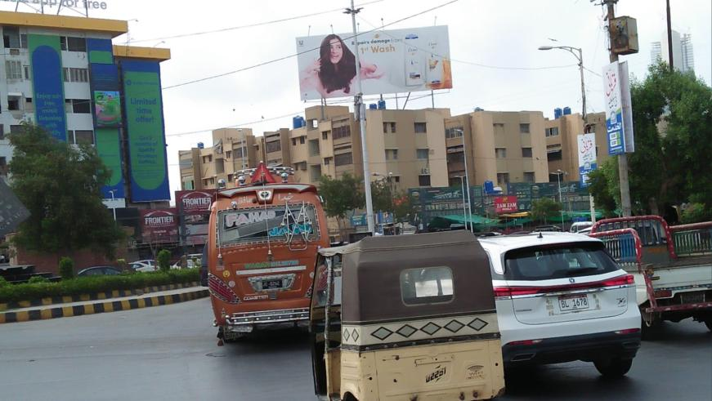
Main Boat Basin Clifton
My Kolachi/Punjab
chowrangi
Bilawal chowrangi
60x25
1,200,000(with Lights)
24-8-2024

Slide 11
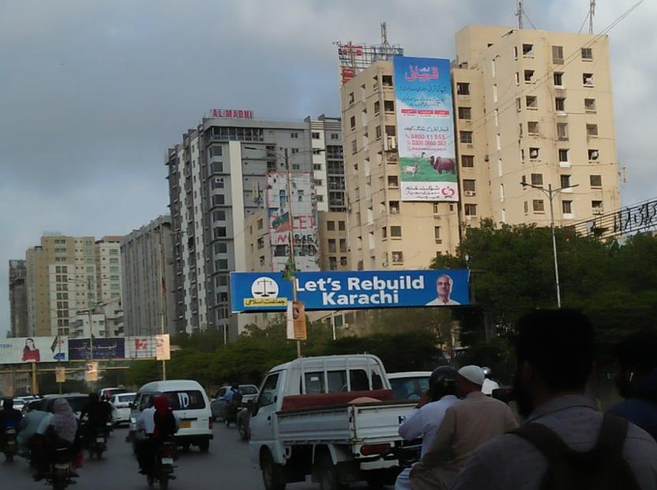
Shahrah-e-Faisal (Nursery) Flex
Share-e-Faisal
Share-e-Faisal (Nursery)
24 x 60
1,300,000
Not available

Slide 12
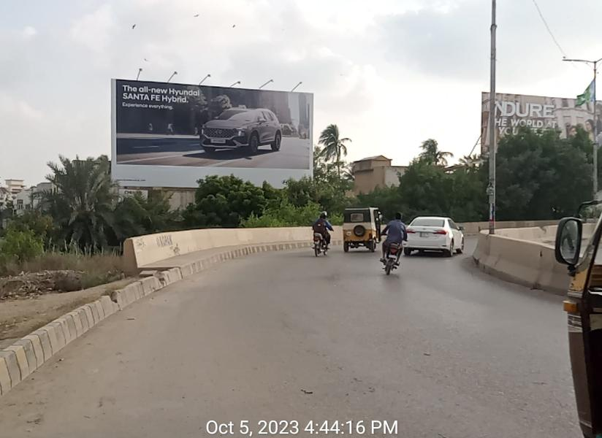
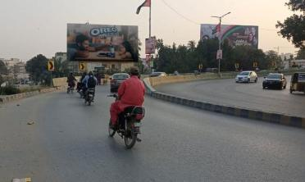
(Nursery) Shahrah-e-Faisal To Share-e- Qaidaeen
Share-e-Faisal
Share-e-QaIdeen
60x30
1,600,000(with Lights)
24-8-2024

Slide 13
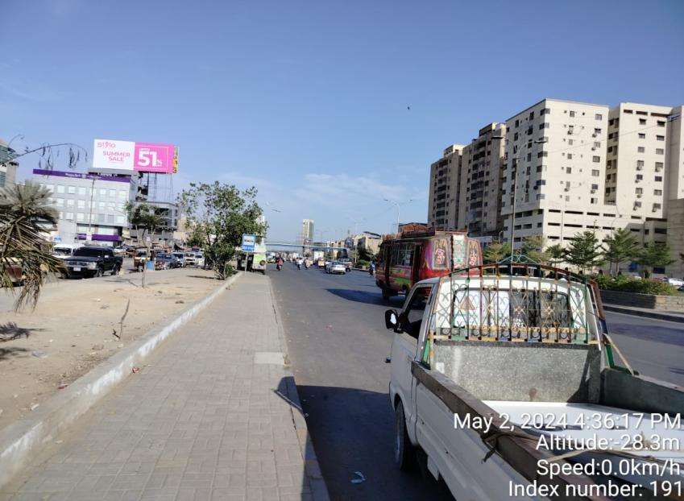
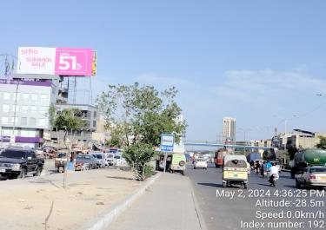
Korangi Road towards Ittehad signal
Defence Mor
Ittehad Signal
80x30
2,500,000 With lights
15-8-2024

Slide 14
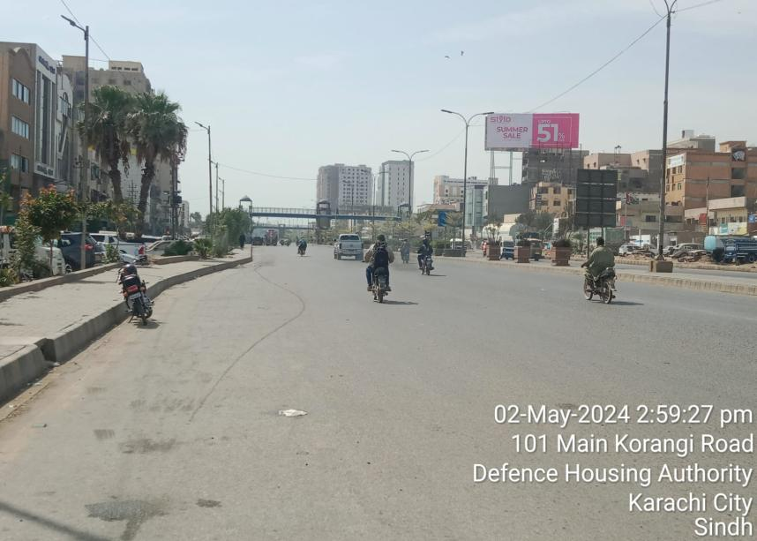
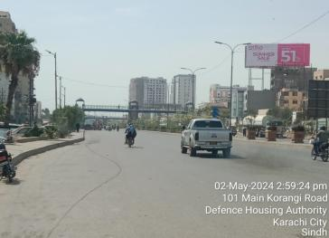
Korangi Road towards DHA Mor
Ittehad Signal
Defense Mor
80x30
2,500,000 With lights
24-8-2024

Slide 15
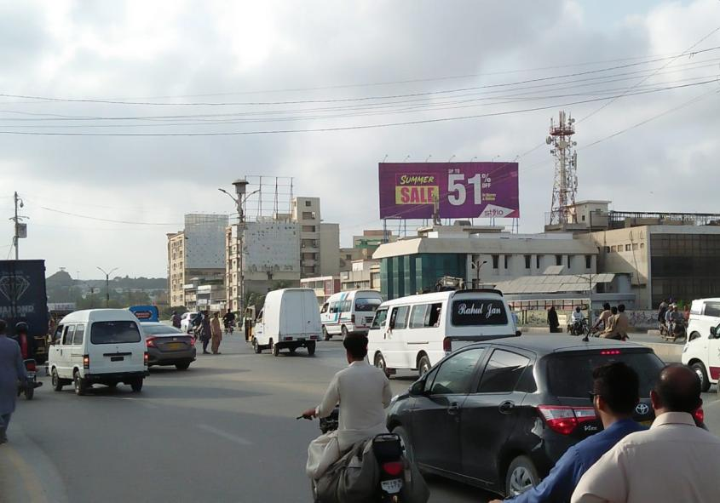
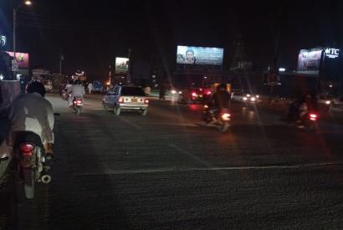
Shaheed Millat Road Baloch Bridge
City school
Baloch Bridge
90x30
2,200,000(with Lights)
22-8-2024

Slide 16
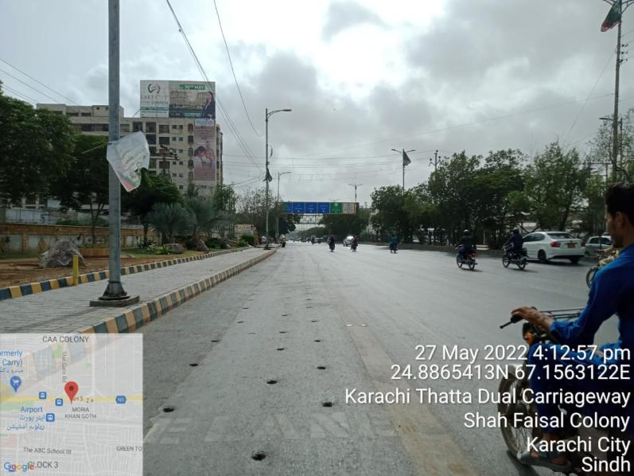
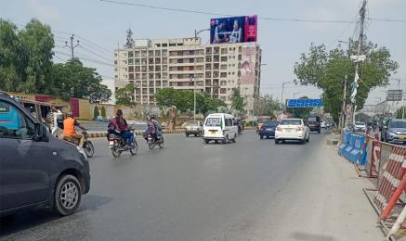
Shahrah-e-Faisal (Star Gate)Flex Facing Airport (with Lights)
Airport
Shahr e Faisal
60x30
1,200,000(with Lights)
15-8-2024

Slide 17
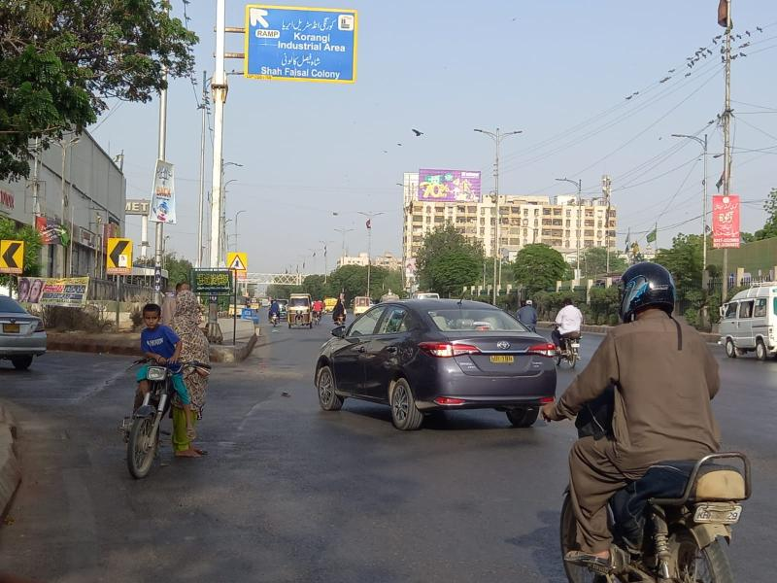
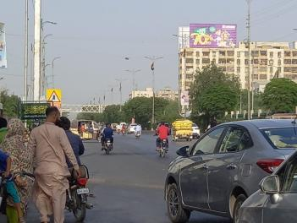
Shahrah-e-Faisal (Star Gate) Going Airport Flex (with Lights)
Shahr e Faisal
Airport
60x30
1,200,000(with Lights)
24-8-2024

Slide 18
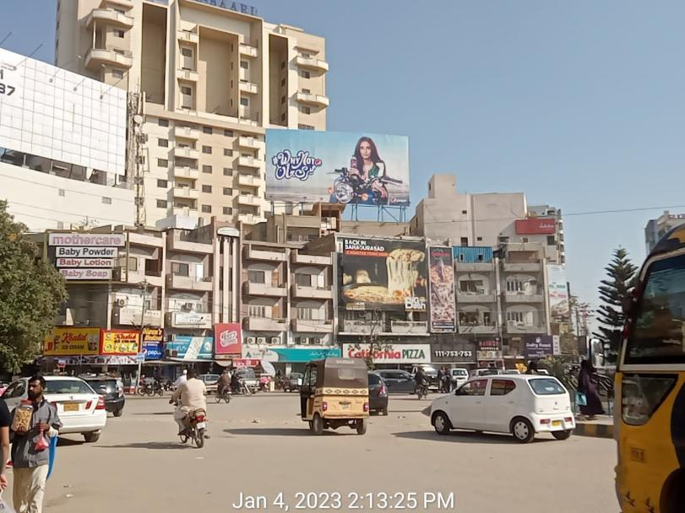
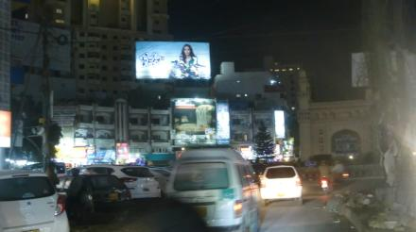
Buhadrabad Chowrangi Dual View
Sharfabad / Tariq Road
Main 4 minar
60x30
1,200,000(with Lights)
20-8-2024

Slide 19
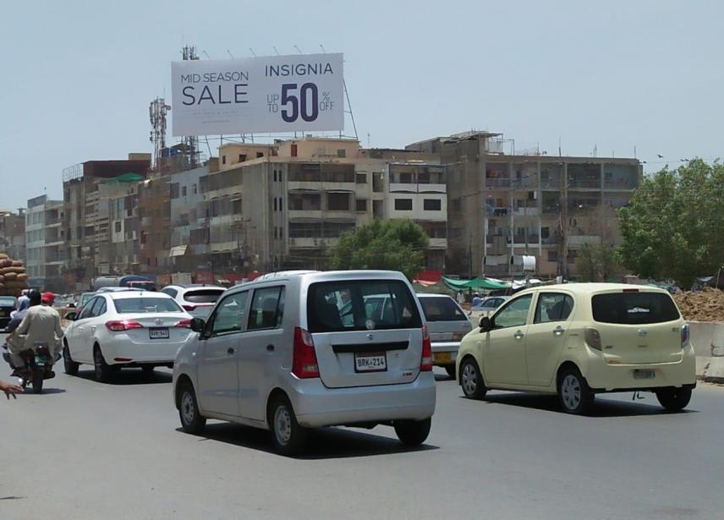
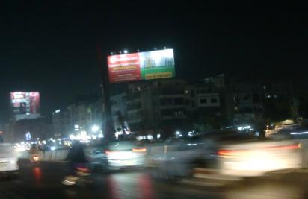
University Road Near Gulshan Market Bait UL Mukarram
Nipa Bridge
Hassan Square
70x30
1,200,000(with Lights)
15-8-2024(ext)

Slide 20
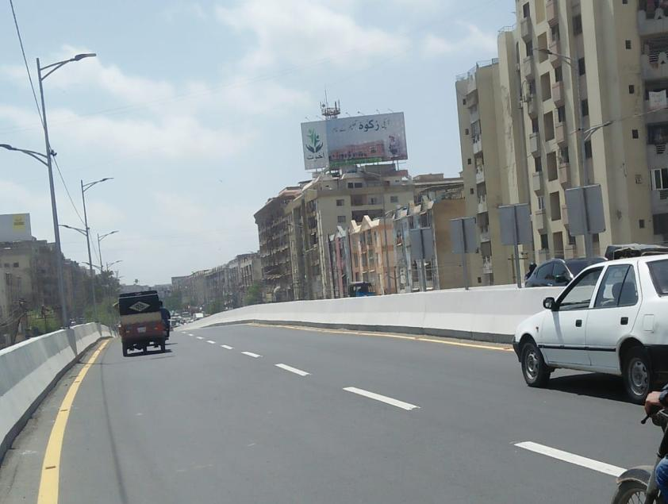
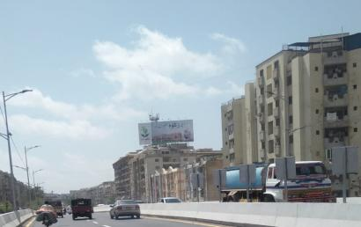
Gulsitan Johar Chowrangi
Nipa
Millennium mall ,Johar Mor
70x30
1,200,000(with Lights)
15-8-2024

Slide 21
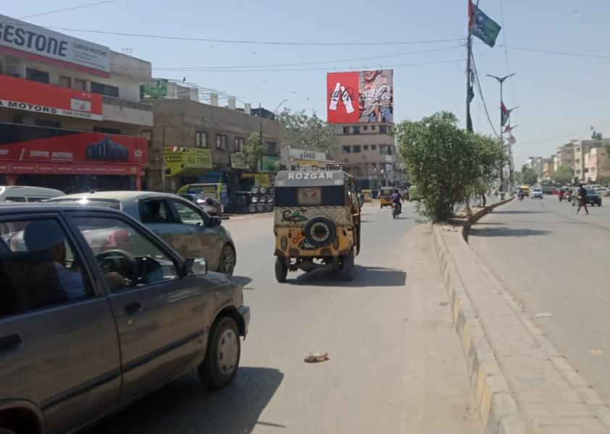
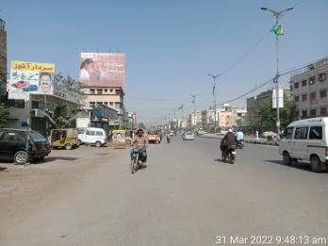
Society Office Shahrah e Quideen
Allah Wali Chowrangi
Quaid Tomb
40x30
800,000(with Lights)
19-8-2024

Slide 22
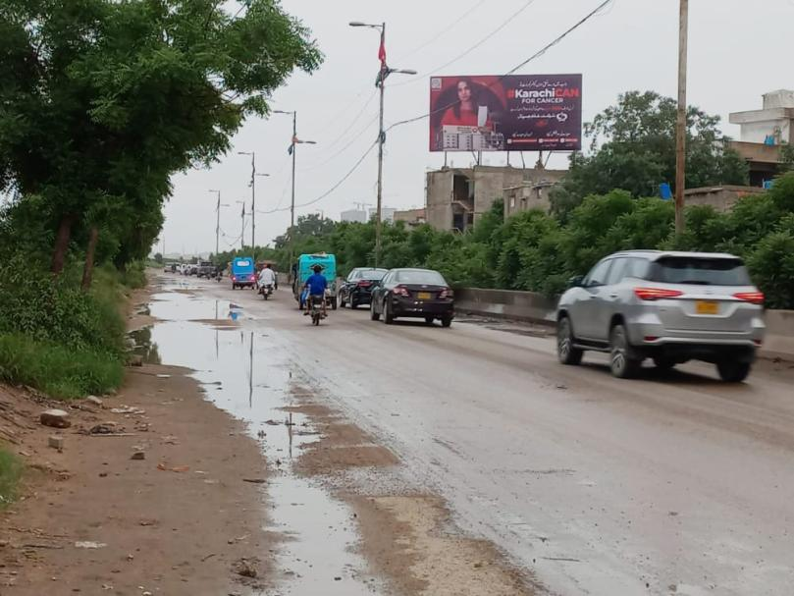
Expressway Baloch Bridge
Baloch Bridge
Defence View
50x25
700,000(with Lights)
30-8-2024

Slide 23
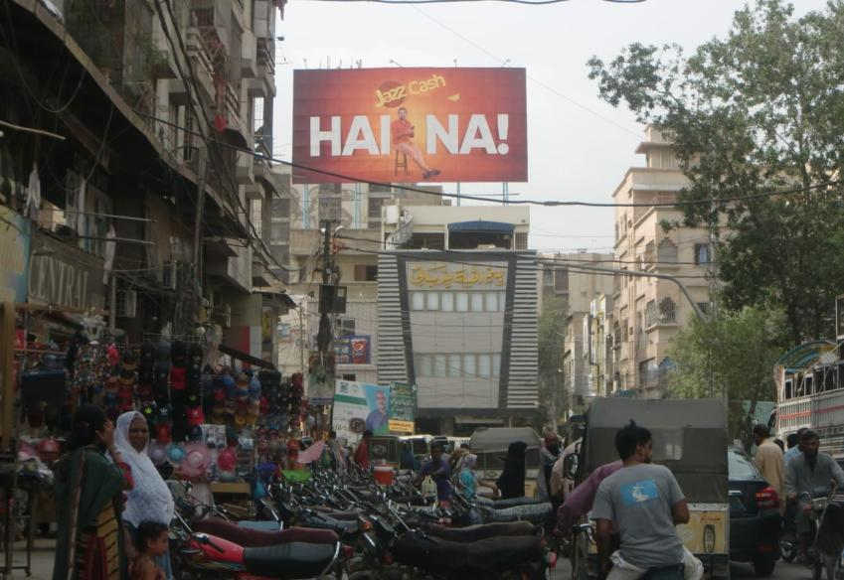
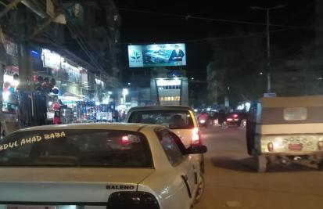
Shah Faisal Road
Korangi Bridge
Shami Center /
Shahrah Faisal
50x25
600,000(with Lights)
20-8-2024

Slide 24
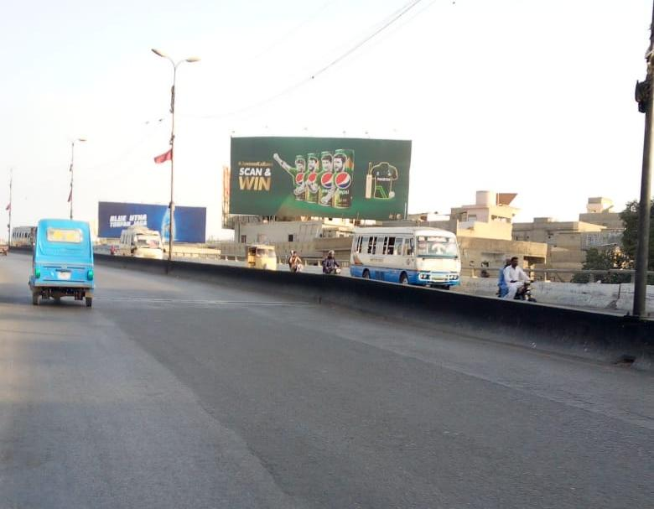
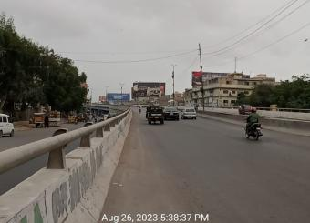
Main Shahrah-e-Faisal, Quaida Abad Flyover
Abott Company / Malir3
Qaida bad
70x30
900,000
30-9-2024

Slide 25
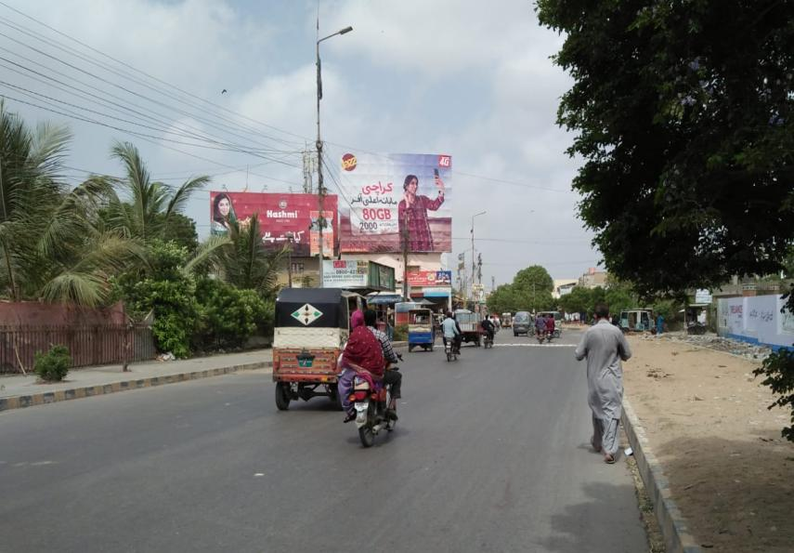
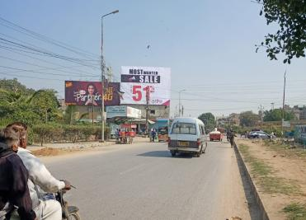
Landi # 1 Baber Market (with Lights)
Babar Market
Quaidabad
40x30
900,000
Immediate

Slide 26
Bridge Panels

Slide 27
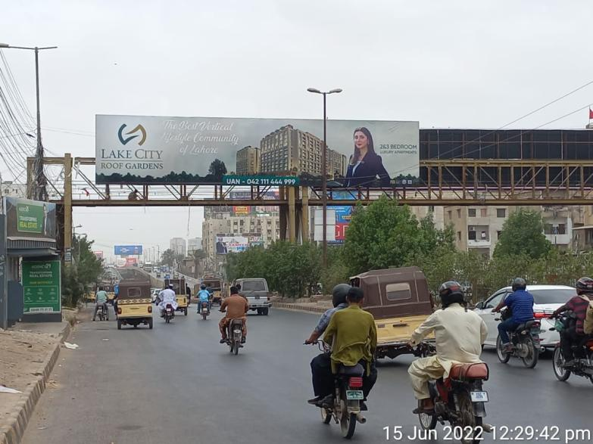
Rashid Minhas Road (Millennium Mall Towards Nipa Flyover)
Millennium Mall
Nipa Flyover
70x15
1,000,000
10-9-2024

Slide 28
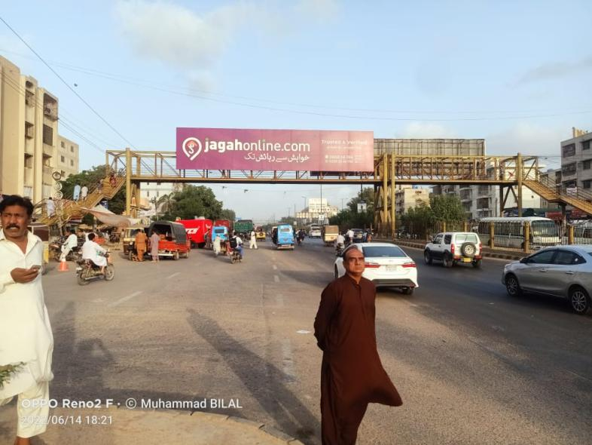
Rashid Minhas Road (Nipa Flyover Towards Millennium Mall)
Nipa Flyover
Millennium Mall
70x15
1,000,000
8-9-2024

Slide 29
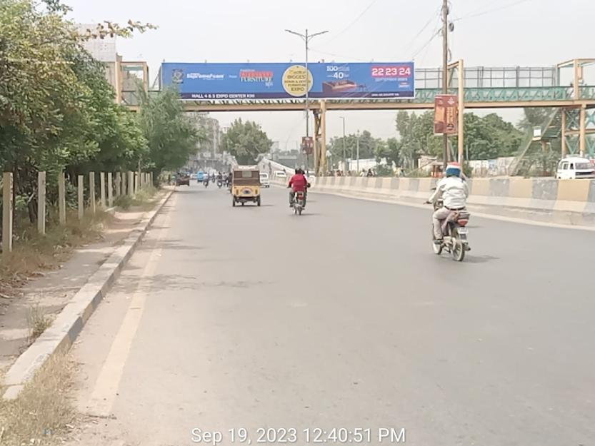
Shahre Faisal Malir Iqra University( Side 1)
Malir Iqra University
Aiport
70x10
800,000/each Side
24-8-2024

Slide 30
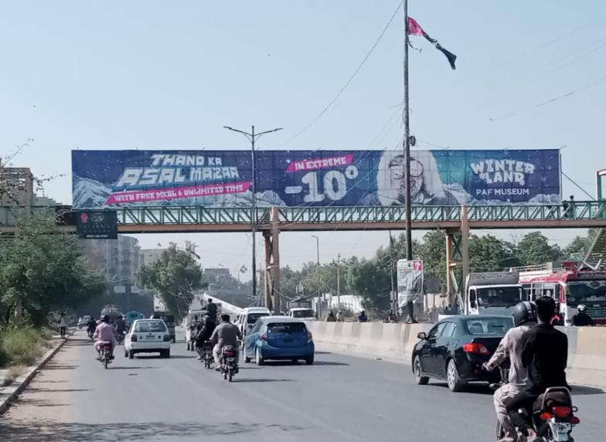
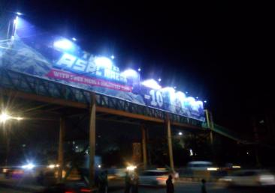
Shahre Faisal Malir Iqra University(Side 2)
Aiport
Malir Iqra University
70x10
800,000/each Side
Immediate

Slide 31
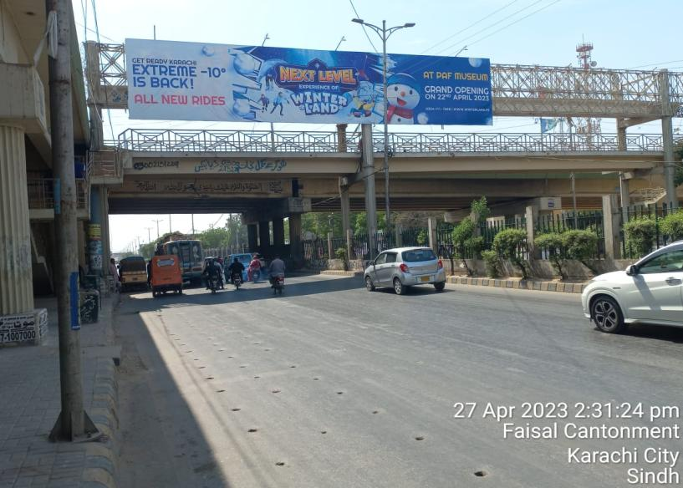
Shah Faisal Pedestrian Shara e Faisal
Shah Faisal Pedestrian
Shara e Faisal
Nursery.
60x12
800,000
9-8-2024

Slide 32
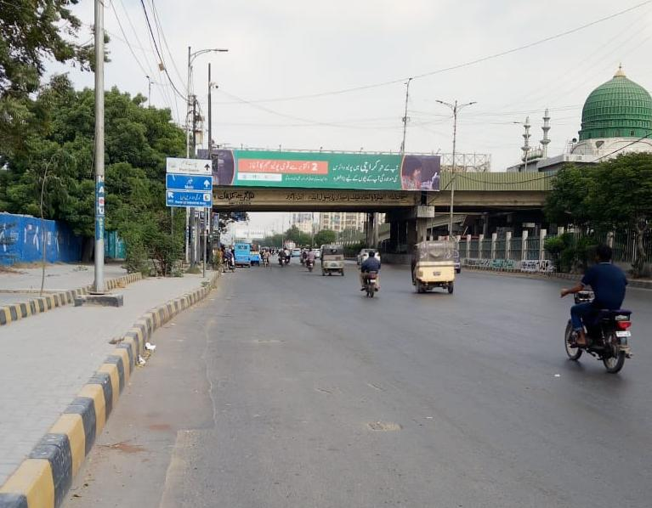

Shah Faisal Flyover
Shah Faisal Flyover
Saddar
70x10
1,000,000
15-8-2024(ext)

Slide 33


University Road Nipa Flyover( Side 1)
Metro store
Expo Center
70x10
800,000
31-8-2024(ext)

Slide 34

University Road Nipa Flyover( Side 2)
Bait ul Mukaram
Metro store
70x10
800,000
15-8-2024

Slide 35

Expressway( Side 1)
Baloch Bridge
Qayyuma bad
50x12
800,000(each Side)
Immediate

Slide 36

Expressway(Side 2)
Qayyuma bad
Baloch Bridge
50x12
800,000(each Side)
Immediate

Slide 37

Agha Khan( Side 1)
Agha Khan
Newtown
48x12
800,000(each Side)
Immediate

Slide 38

Agha Khan(Side 2)
Newtown
Agha Khan
48x12
800,000(each Side)
Immediate

Slide 39

Serena Mobile Market ( Side 1)
Nagan Chorangi
Five Star.
100x12
1,000,000 each Side
Immediate

Slide 40

Serena Mobile Market (Side 2)
Five Star.
Nagan Chorangi
100x12
1,000,000 each Side
Immediate(hold)

Slide 41

Qayuma bad Fly Over Front of Imtiaz
70x10
800,000
Immediate(hold)

Slide 42

Qayuma bad Fly Over
Qayumabad Fly Over
Kabab jee express way
70x10
800,000
Immediate

Slide 43

Imtiaz Nazimabad Pedestrian
Imtiaz Nazimabad
Pedestrian
Lasbila
70x10
1,200,000
Immediate

Slide 44

Imtiaz Nazimabad
Imtiaz Nazimabad
Hyderi Market ,Board office
70x10
1,200,000
Immediate(hold)

Slide 45

Gulshan Chorangi
Gulshan Chorangi
Lucky one
70x10
800,000
Immediate

Slide 46

Gulshan Pedestrian Luckyone
Gulshan Chorangi
Nipa
60x10
800,000
10-8-2024

Slide 47


Civic Center Flyover
Civic Center Flyover
Urdu Science College.
70x10
800,000/each side
Immediate(hold)

Slide 48

Civic Center Flyover
Urdu Science College.
Civic Center Flyover
70x10
800,000/each side
Immediate(hold)

Slide 49

Stadium Main Gate Dalmia
Stadium Main Gate Dalmia
Time Medico
70x10
800,000
Immediate

Slide 50

Millennium Mall
Millenium Mall
Airport Shara e faisal
Both Sided Road.
70x10
800,000
Immediate

Slide 51
Digital Media

Slide 52
Lahore

Slide 53


Noor Jahan Road ( Liberty )
GEOMAPPING
https://www.google.com/maps/d/edit?mid=1S5LwxGRoufbvZJYW8HFCDnql5xvveytc&usp=sharing
 | SIZE | LOCATION | QTY | Duration | Time Slot | Total Time Per Day | Total Brand Per Day | Each Brand Slot Per Day | Rate Per Slot
 | 3 x 6 | Noor Jahan Road | 54 | 1 week | 15 Sec | 12 Hours | 6 Slot | 480 | 550,000

Slide 54

DD Block outside Gold Crest Mall
 | SIZE | LOCATION | QTY | Duration | Time Slot | Total Time Per Day | Time Per Brand Per Day | Total Brand Per Day | Each Brand Slot Per Day | Rate Per Slot
 | 3 x 6 | DD Block outside Gold Crest Mall | 52 | 1 week | 15 Sec | 12 Hours | 2 Hours | 6 Slot | 480 | 600,000

Slide 55


Iqbal Town Main Boulevard
 | SIZE | LOCATION | QTY | Duration | Time Slot | Total Time Per Day | Total Brand Per Day | Each Brand Slot Per Day | Rate Per Slot
 | 3 x 6 | Iqbal Town Main Boulevard | 66 | 1 Week | 15 Sec | 12 Hours | 6 Slot | 480 | 500,000

Slide 56

Shaukat Khanum Flyover
 | SIZE | LOCATION | QTY | Duration | Time Slot | Total Time Per Day | Total Brand Per Day | Each Brand Slot Per Day | Rate Per Slot
 | 3 x 6 | Shaukat Khanum Flyover | 40 | 1 week | 15 Sec | 12 Hours | 6 Slot | 480 | 500,000

Slide 57

Model Town Link Road
 | SIZE | LOCATION | QTY | Duration | Time Slot | Total Time Per Day | Total Brand Per Day | Each Brand Slot Per Day | Rate Per Slot
 | 3 x 6 | Model Town Link Road | 60 | 1 Week | 15 Sec | 12 Hours | 6 Slot | 480 | 600,000

Slide 58

Doctor Hospital to G1 Market
 | SIZE | LOCATION | QTY | Duration | Time Slot | Total Time Per Day | Time Per Brand Per Day | Total Brand Per Day | Each Brand Slot Per Day | Rate Per Slot
 | 3 x 6 | Doctor Hospital to G1 Market | 40 | 1 Week | 15 Sec | 12 Hours | 2 Hours | 6 Slot | 480 | 450,000

Slide 59
G1 Market to Khokar Chowk
 | SIZE | LOCATION | QTY | Duration | Time Slot | Total Time Per Day | Time Per Brand Per Day | Total Brand Per Day | Each Brand Slot Per Day | Rate Per Slot
 | 3 x 6 | G1 Market to Khokar Chowk | 40 | 1 Week | 15 Sec | 12 Hours | 2 Hours | 6 Slot | 480 | 450,000

Slide 60
Khokar Chowk to Emporium Mall/Expo Center
 | SIZE | LOCATION | QTY | Duration | Time Slot | Total Time Per Day | Time Per Brand Per Day | Total Brand Per Day | Each Brand Slot Per Day | Rate Per Slot
 | 3 x 6 | Khokar Chowk to Emporium Mall/Expo Center | 50 | 1 Week | 15 Sec | 12 Hours | 2 Hours | 6 Slot | 480 | 450,000

Slide 61

Electronics Abid Market to Mall Road
 | SIZE | LOCATION | QTY | Duration | Time Slot | Total Time Per Day | Time Per Brand Per Day | Total Brand Per Day | Each Brand Slot Per Day | Rate Per Slot
 | 3 x 6 | Electronics Abid Market to Mall Road | 36 | 1 Week | 15 Sec | 12 Hours | 2 Hours | 6 Slot | 480 | 375,000

Slide 62

Punjab University To Canal
 | SIZE | LOCATION | QTY | Duration | Time Slot | Total Time Per Day | Time Per Brand Per Day | Total Brand Per Day | Each Brand Slot Per Day | Rate Per Slot
 | 3 x 6 | Punjab University To Canal | 36 | 1 Week | 15 Sec | 12 Hours | 2 Hours | 6 Slot | 480 | 450,000

Slide 63

Pine Avenue Road(Chattri Chowk To Valencia)
 | SIZE | LOCATION | QTY | Duration | Time Slot | Total Time Per Day | Time Per Brand Per Day | Total Brand Per Day | Each Brand Slot Per Day | Rate Per Slot
 | 3 x 6 | Pine Avenue Road(Chattri Chowk To Valencia) | 68 | 1 Week | 15 Sec | 12 Hours | 2 Hours | 6 Slot | 480 | 600,000

Slide 64

Bahria Town
 | SIZE | LOCATION | QTY | Duration | Time Slot | Total Time Per Day | Time Per Brand Per Day | Total Brand Per Day | Each Brand Slot Per Day | Rate Per Slot
 | 3 x 6 | Bharia Town | 50 | 1 Week | 15 Sec | 12 Hours | 2 Hours | 6 Slot | 480 | 300,000

Slide 65

Jail Road
 | SIZE | LOCATION | QTY | Duration | Time Slot | Total Time Per Day | Total Brand Per Day | Each Brand Slot Per Day | Rate Per Slot
 | 40x20 | Jail Road | 1 | 1 week | 30 Sec | 12 Hours | 6 Slot | 240 | 400,000

Slide 66

CBD Kalma Chowk
 | SIZE | LOCATION | QTY | Duration | Time Slot | Total Time Per Day | Total Brand Per Day | Each Brand Slot Per Day | Rate Per Slot
 | 40x20 | CBD Kalma Chowk | 1 | 1 week | 30 Sec | 12 Hours | 6 Slot | 240 | 400,000

Slide 67

Wapda Town Round About SMD
 | SIZE | LOCATION | QTY | Duration | Time Slot | Total Time Per Day | Total Brand Per Day | Each Brand Slot Per Day | Rate Per Slot
 | 50x20 | Wapda Town Round About | 1 | 1 week | 30 Sec | 12 Hours | 6 Slot | 240 | 300,000

Slide 68

Morr Chowk Signal Bahria Town SMD
 | SIZE | LOCATION | QTY | Duration | Time Slot | Total Time Per Day | Total Brand Per Day | Each Brand Slot Per Day | Rate Per Slot
 | 40x20 | Morr Chowk Signal Bahria Town | 1 | 1 week | 30 Sec | 12 Hours | 6 Slot | 240 | 300,000

Slide 69
Static Media

Slide 70
Lahore

Slide 71



Jinnah Flyover Vinyl Panel U Shape (with Lights)
GEOMAPPING
https://www.google.com/maps/d/edit?mid=1S5LwxGRoufbvZJYW8HFCDnql5xvveytc&usp=sharing
Khalid Butt
Firdouse Market
183x32
6 Million(with Lights)
15-8-2024

Slide 72

Jinnah Flyover (with Lights)
Firdous Market
Khalid Butt
90x30
3.5 Million(with Lights)
21-8-2024

Slide 73

Jinnah Flyover (with Lights)
Khalid Butt
Firdous Market
45x30
1,700,000(with Lights)
24-08-2024

Slide 74

Hussain Chowk Roundabout Vinyl Panel
GEOMAPPING
https://www.google.com/maps/d/edit?mid=1S5LwxGRoufbvZJYW8HFCDnql5xvveytc&usp=sharing
Liberty Market
M M Alam road, Mini market
90X32
4 million(with Lights)
31-12-2024

Slide 75

Hussain Chowk Roundabout
MM alam road and
Kasuri road
Liberty chowk and Firdouse
market
60 x 20
1,800,000
25-8-2024

Slide 76


DHA Khayaban e Iqbal Signal
Walton road
Khayaban e Iqbal XX
120X40
5.5 million(with Lights)
Immediate

Slide 77


DHA Dolmen Mall Nawaz Sharif Interchange
Dolmen Mall
Dolmen Mall
Airport, Lahore Entrance
DHA Phase 6, Bahria ,Lake City
90 x 30
2,700,000
20-8-2024

Slide 78


Near DHA Dolmen Mall Nawaz Sharif Interchange
DHA Phase 6, Bahria ,Lake City
Airport, Lahore Entrance
60x30
1,800,000
Immediate

Slide 79

Sherpao Bridge
Gulberg , Jail Road
Shami Chowk Fortress Cantt,
The Mall of Lahore
60 X 20
2,000,000
24-08-2024

Slide 80

Sherpao Bridge
Cantt
Gulberg
90x20
2,200,000
21-8-2024

Slide 81


Firdous Market Signal
Hussain Chowk,
MM Alam Road
Kalma Chowk,
Cavalary Ground
90x30
2,800,000(with Lights)
12-08-2024(ext)

Slide 82

MM Alam road
Main Market and
Mini Marekt
Hussain Chowk, Liberty
and Firdous Market
40 x 30
1,500,000
15-8-2024

Slide 83

MM Alam road
Hussain Chowk, Liberty
and Firdous Market
Main Market and
Mini Marekt
30 x 40
1,500,000
21-8-2024

Slide 84

Calvary Ground
Firdous Market,
Hussain Chowk
DHA, Calvary Ground
44 x20
1,200,000
28-8-2024

Slide 85


Main Boulevard DHA
H BLOCK, MASJID CHOWK
DHA MORR. WALTON,
CHAND MARI CHOWK
30x35
1,400,000(with Lights)
20-8-2024

Slide 86

Kalma Chowk
Muslim Town
Gulberg
60x20
1,200,000
5-9-2024

Slide 87

Muslim Town Flyover
Kalma Chowk,Garden Town
Wahdat Road, Ichra
60x20
900,000(with lights)
Immediate

Slide 88

Muslim Town Flyover
Ichra, Mazong
Kalma Chowk,Garden Town
40x30
800,000(with lights)
26-8-2024

Slide 89

Model Town Link Road
Model town, Metro
Model Town Link
Road Signal, Peco, Township
40x30
850,000(with Lights)
9-8-2024

Slide 90

Ferozpur Road Qartaba Chowk (With Lights)
GEOMAPPING
https://www.google.com/maps/d/edit?mid=1S5LwxGRoufbvZJYW8HFCDnql5xvveytc&usp=sharing
Littion Road & Abid Market
Muslim Town
30x40
1,000,000(with Lights)
19-8-2024

Slide 91


Main Jail Road (with Lights)
GEOMAPPING
https://www.google.com/maps/d/edit?mid=1S5LwxGRoufbvZJYW8HFCDnql5xvveytc&usp=sharing
Jail Road, Shadman Chowk
Mozang Chowk ,
Ferozpur Road
40x30
850,000(with Lights)
21-8-2024

Slide 92


Jawad Cheema Chowk (with Lights)
GEOMAPPING
https://www.google.com/maps/d/edit?mid=1S5LwxGRoufbvZJYW8HFCDnql5xvveytc&usp=sharing
Golf Club, Mall Road
Askari X, Airport, Ring Road
60x20
850,000(with Lights)
25-8-2024

Slide 93


Tikka Khan Chowk G-1 Johar Town
Canal Road & Dr Hospital
Emporium Mall, Expo Centre
60 x 20
1,050,000(with Lights)
3-09-2024

Slide 94


G1 Market Johar Town
Emporium Mall,Expo Center
Doctor Hospital,G1 Market
40 x 30
950,000(with Lights)
21-8-2024

Slide 95


PIA Road Facing Wapda Town
Wapda Town
Akbar Chowk & college Road
60 x 20
800,000(with Lights)
25-8-2024

Slide 96


Kader Topbash Chowk/ Chattri Chowk
Valencia town,
Lake City,LDA Signal
LDA, Shoukat Khanam,Ucp
60 x 20
950,000(with Lights)
24-08-2024

Slide 97


Kader Topbash Chowk/ Chattri Chowk
Valencia town,
Lake City,LDA Signal
LDA, Shoukat Khanam,Ucp
90 x 30
2,200,000(with Lights)
21-8-2024

Slide 98


Kader Topbash Chowk/ Chattri Chowk
Valencia town,
Lake City,LDA Signal
LDA, Shoukat Khanam,Ucp
60 x 20
950,000(with Lights)
3-9-2024

Slide 99


Punjab Bank Chowk, Valencia, Johar Town
Chatri Chowk &
Rahbar DHA
Lake City, Pine Avenue
60 x 20
900,000
30-8-2024

Slide 100

Shanu Baba Roundabout
Valencia Chattri chowk defense road
Lake city and again Valencia bhubtian
60 x 30
1,400,000
Immediate

Slide 101
Shanu Baba Roundabout
Valencia Chattri chowk defense road
Lake city and again Valencia bhubtian
60 x 30
1,400,000
28-8-2024

Slide 102
Shanu Baba Roundabout
Valencia Chattri chowk defense road
Lake city and again Valencia bhubtian
120 x 30
2,500,000
28-8-2024

Slide 103


Adda Plot Roundabout
Raiwind road, Bahria orchid,
LDA Avenue, Valencia
Lake city, Pine Avenue,Fazaia,
Bahria Orchid
76 x 30
1,400,000
20-8-2024

Slide 104
Adda Plot Roundabout
Raiwind road, Bahria orchid,
LDA Avenue,Valencia
Lake city, Pine Avenue,Fazaia,
Bahria Orchid
90 x 30
1,800,000
26-8-2024

Slide 105

LDA Signal Going Towards ADDA Plot
Thokar,Abdul Star Edhi Road
Adda Plot, Bhubtian,
Lake City
60 x 20
750,000
Immediate

Slide 106


Chuburji Chowk
Multan Road, Sacheem Mor
MAO College, Data Darbar
50 x 24
850,000
20-8-2024

Slide 107


Band Road Near Gulshan Ravi
Babu Sabu Motorway
Sabzazar
60 x 20
550,000
Immediate

Slide 108


Azadi Chowk Flyover
Data Darbar
Timber Market, Larri Adda
30 x 40
850,000(with lights)
5-9-2024

Slide 109


Azadi Chowk Flyover (Dual View)
Timber Market, Larri Adda
Data Darbar
60 x 20
850,000
21-8-2024

Slide 110

Shah Alam Chowk (With Lights)
GEOMAPPING
https://www.google.com/maps/d/edit?mid=1S5LwxGRoufbvZJYW8HFCDnql5xvveytc&usp=sharing
Shah Alam Market
Urdu Bazar
50 x 20
600,000(with lights)
8-8-2024(extendable)

Slide 111


Main Larri Adda Roundabout Badami Bagh (Dual View)
Ravi Road, Data Darbar,
Yadgar flyover
Lahore Railway Station
/Walled City & Saddar & Cantt
25 x 50
550,000(with Lights)
Immediate

Slide 112


Motorway Toll Plaza Towards Islamabad
Babu sabu Interchange
Islamabad
90 x 30
1,000,000
Immediate

Slide 113


Eastern by pass Motorway
Lahore
Sialkot,Kala shah Kaku
90 x 30
1,200,000
Immediate

Slide 114


Sialkot To Lahore Entrance
Sialkot
Lahore
90 x 30
1,200,000
Immediate

Slide 115
Sheikhupura

Slide 116

32 Chowk Sheikhupura
Lahore
Faisalabad Motorway ,Shahdra Chowk
60 x 20
350,000
15-8-2024

Slide 117
32 Chowk Sheikhupura
Lahore
Faisalabad Motorway ,Shahdra Chowk
60 x 20
350,000
21-8-2024

Slide 118
Faisalabad

Slide 119

Satyana Road.
Saleemi Chowk
D Ground FSD
60 x 20
350,000
7-8-2024(ext)

Slide 120

Abdullah Under Pass
Abdullah Under Pass
Jhal Chowk & Satyana Road & Sumndri Road, FSD.
60 x 20
350,000
10-8-2024(ext)

Slide 121

Jamia Chishtiyan Chowk
Mor & Sargodha
Faisalabad
60 x 20
350,000
Immediate(hold)

Slide 122
Rawalpindi

Slide 123



Srinagar Highway Opp Eighteen
26 number, Airport
Airport
101 x 41
1,000,000
Immediate

Slide 124

Siri Nagar Highway
Motorway
Airport, Lahore, PSW Junction
50 x 25
350,000
16-12-2024 (ext)

Slide 125


Asghar Mall Muree Road near Naz Cenima
Committe Chowk
Faizabad , Muree Road & Chandani Chowk Flyover
31 x 31
300,000
26-12-2024(ext)

Slide 126


Commercial Flyover
GEOMAPPING
https://www.google.com/maps/d/edit?mid=1S5LwxGRoufbvZJYW8HFCDnql5xvveytc&usp=sharing
Committee Chowk, Commercial Market
Stadium Road, Faizabad, Islamaba
60 x 20
350,000
23-4-2025(ext)

Slide 127


KhanaPul
Islamabad Lethar Road
Rawalpindi
60 x 20
350,000
Immediate

Slide 128


Liaquat Bagh Chowk
Raja Bazar
Muree Road
40 x 30
300,000
1-9-2024(ext)

Slide 129


Khanapul Bridge Towards Lehtaral Road Islamabad
Lehtar Road Islamabad
Bharia Enclave and Parkview
60 x 20
350,000
4-9-2024(ext)

Slide 130

Bharia Enclave Road Islamabad
Bharia Enclave and Parkview
Society
50x25
250,000
1-9-2024(ext)

Slide 131

Bharia Town Capital Avenue Gate Exit phase 4
Bahria Town
PWD Police Foundation Entrance, Islamabad
60x20
300,000
16-8-2024

Slide 132
Digital Media

Slide 133

Commercial Market Rawalpindi Digital
 | SIZE | LOCATION | QTY | Duration | Time Slot | Total Time Per Day | Total Brand Per Day | Each Brand Slot Per Day | Rate Per Slot
 | 3 x 6 | Commercial Market Rawalpindi | 54 | 1 Week | 15 Sec | 12 Hours | 6 Slot | 480 | 350,000

Slide 134


Murree Road 6th Flyover To Chandni Chowk Flyover Digital
 | SIZE | LOCATION | QTY | Duration | Time Slot | Total Time Per Day | Total Brand Per Day | Each Brand Slot Per Day | Rate Per Slot
 | 3 x 6 | Murree Road | 42 | 1 Week | 15 Sec | 12 Hours | 6 Slot | 480 | 350,000

Slide 135
Thank You

