Slide 1

KARACHI

Slide 2
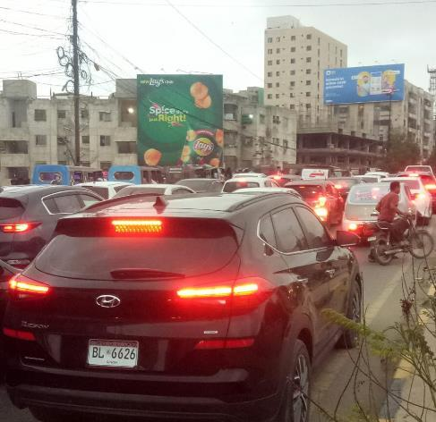

Direction :
TCF Jauhar Chowrangi TGT Jauhar Morr
Size : 31x39 ft
Availability :
Available
Move IDX:
799667
Supreme Castle Gulistan e Jauhar

Slide 3
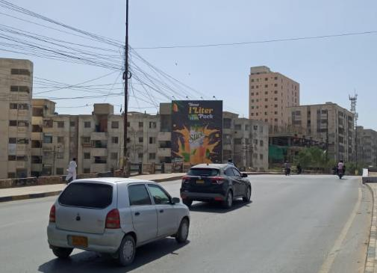
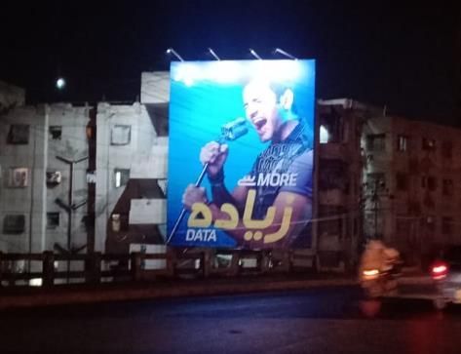
Supreme Castle Gulistan e Jauhar

Slide 4
LAHORE

Slide 5
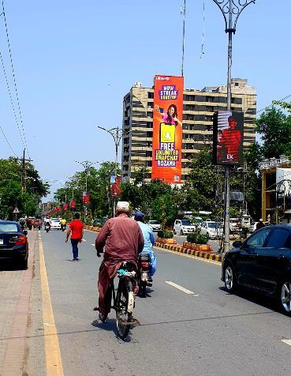
Direction :
Traffic Coming from Hussain Chowk and going towards Mini Market
Size :
120ft x 32ft Vertical (3840 sq.ft)
Availability : Available
Move IDX:
800510
MM ALAM ROAD

Slide 6
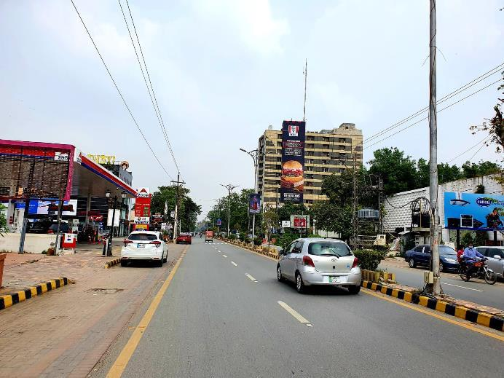

Slide 7
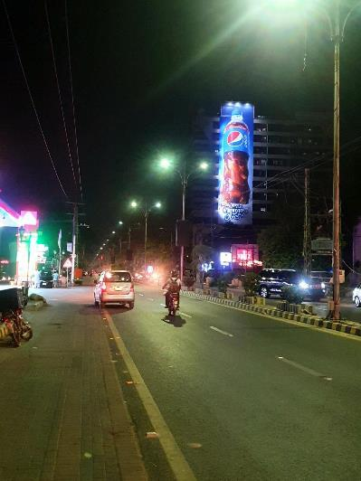
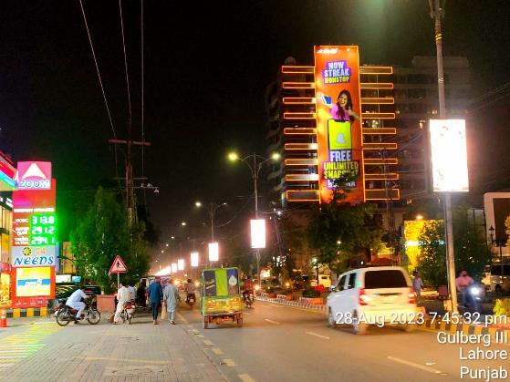

Slide 8
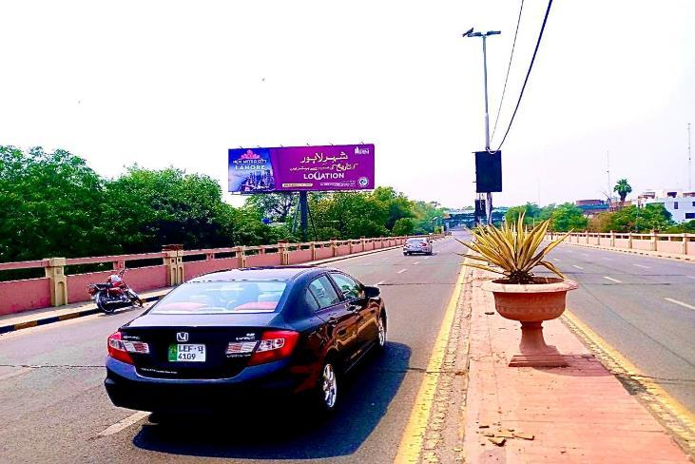
Direction :
Facing Cantt Fortress And Going Towards Mall Road
Size : 60x20 ft
Availability :
15-06-24
Move IDX:
801607
Mian Mir Bridge Facing Cantt

Slide 9
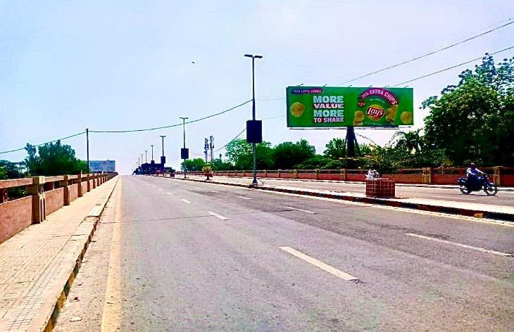
Direction :
Facing Mall road and Going Towards Fortress Cantt and Dha
Size : 60x20 ft
Availability :
Available
Move IDX:
801606
Mian Mir Bridge Facing Mall Road

Slide 10
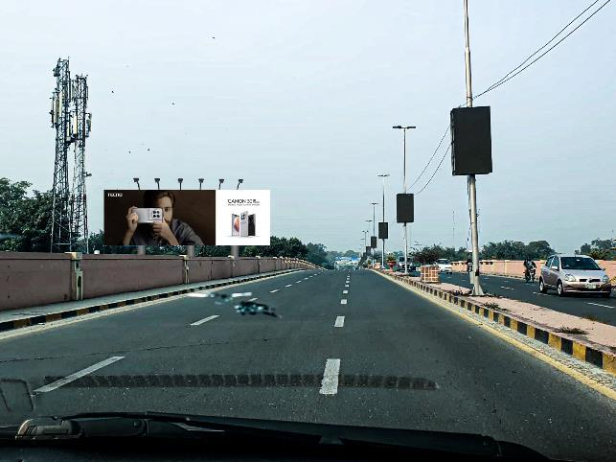
Direction :
FTCF Cantt Fortress Stadium and Going towards Mall Road.
Size : 90x30 ft
Availability :
01-06-24
Mian Mir Bridge Facing Cantt

Slide 11
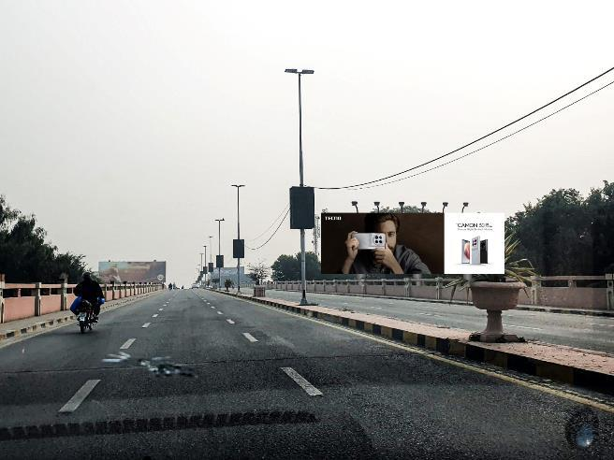
Direction :
FTCF Mall Road and Going towards Cantt and Fortress Stadium.
Size : 90x30 ft
Availability :
01-06-24
Mian Mir Bridge Facing Mall Road

Slide 12
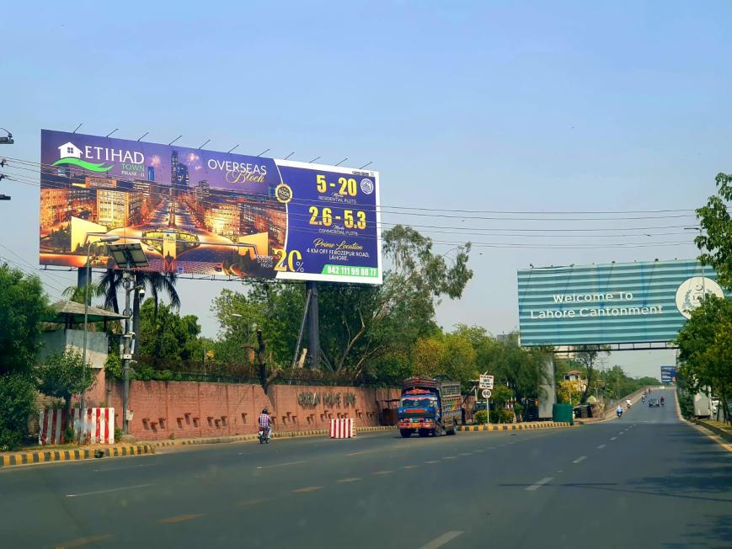
Direction :
FTCF Jail Rad, Main Blvd Gulberg and Going towards Shami Chowk.
Size : 90x30 ft
Availability :
Available
Sherpao Bridge

Slide 13
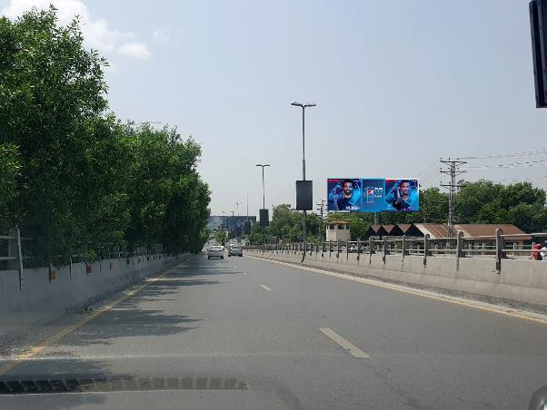
Direction :
Facing Traffic Coming From Cantt and Going Towards Jail Road.
Size : 45x15 ft
Availability :
01-06-24
Sherpao Bridge

Slide 14
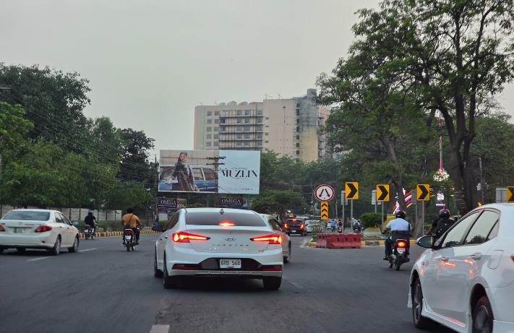
Direction :
Traffic Coming from Liberty To Kalma Chowk
Size : 50x24 ft
Availability:
01-07-24
Liberty Round About

Slide 15
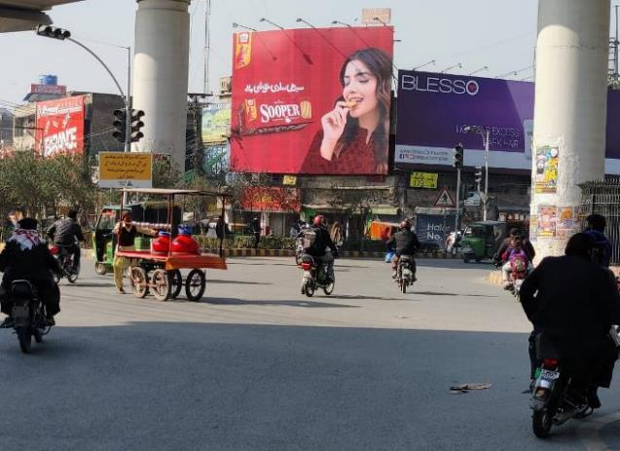
Direction :
Traffic Coming from Qartaba Chowk and GT Multan Road and District Court.
Size : 40x30 ft
Availability :
24-06-24
Move IDX:
800643
Chuburji Chowk

Slide 16
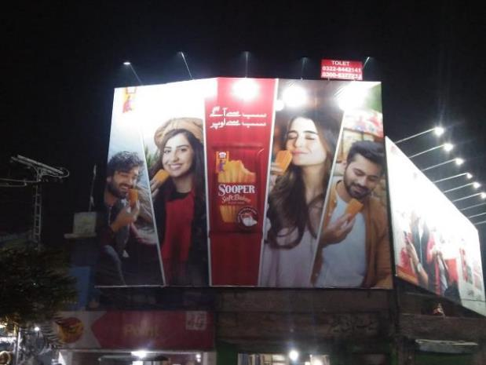
Chuburji Chowk

Slide 17
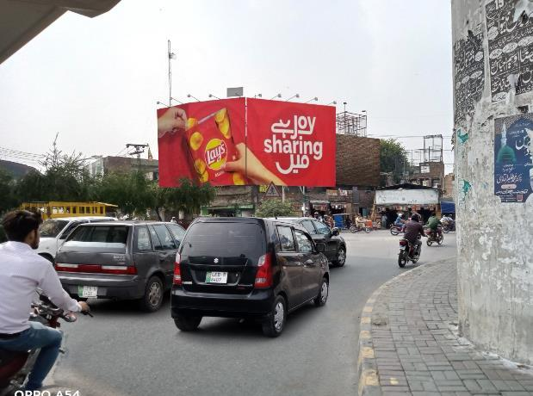
Direction :
Traffic Coming from Qartaba Chowk and GT Multan Road and District Court.
Size : 80x30 ft
Availability :
24-06-24
Chuburji Chowk
Move IDX:
800643

Slide 18
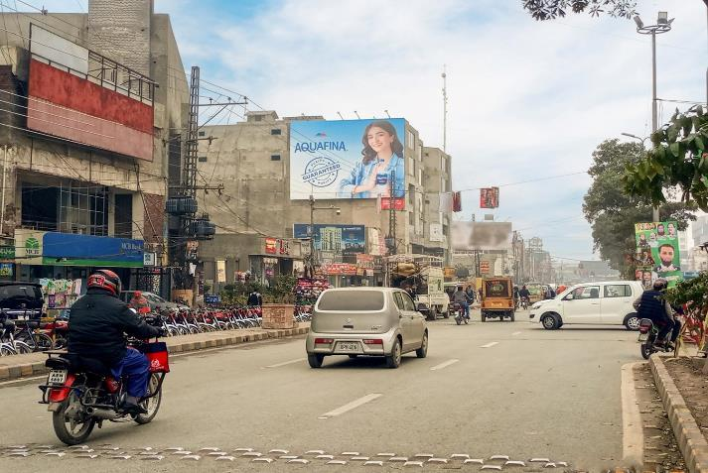
Direction :
Traffic Coming from Model Town and GT Johar Town and Peco Road.
Size : 40x30 ft
Availability :
20-06-24
Move IDX:
801262
Model Town Link Road

Slide 19
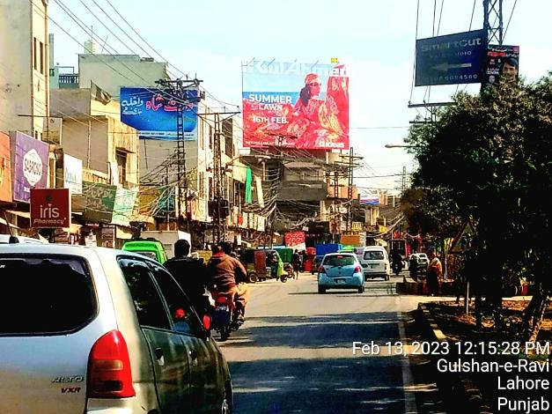
Direction :
Traffic Coming from Gulshan Ravi Bund Road and GT Multan Road and Samnabad.
Size : 40x30 ft
Availability :
25-06-24
Move IDX:
801445
Moon Market Gulshan Ravi

Slide 20
MULTAN

Slide 21
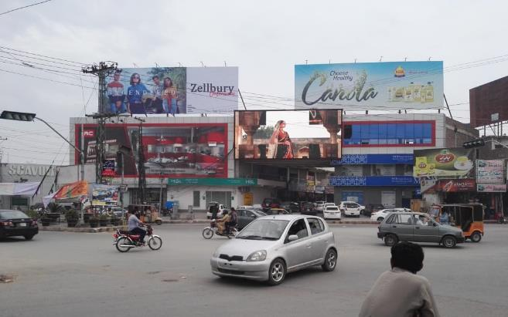
Facing :
Chungi No
6, Bosan Road.
Moving Toward :
Lahore By Pass, BZU University .
Size : 60x20
Nawan Shahr Chowk

Slide 22
Facing :
Chungi No
6, Bosan Road.
Moving Toward :
Lahore By Pass, BZU University .
Size : 60x20
Nawan Shahr Chowk

Slide 23
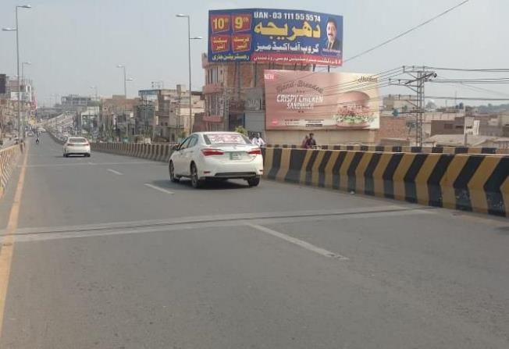
Facing :
Kalma Chowk .
Moving Toward :
Chungi No 9 & Gulgashat Chowk
Size : 50x20
Katchery Flyover

Slide 24
Thanks!
Do you have any questions?
candidmarketing21@gmail.com
+92 300-8377233
+92 345-4411400

