Slide 1


Portfolio

Slide 2
Introduction
ADSUM is an indoor & outdoor advertising company, formed in 1995 since then, the company is serving its clients with commitment and confidence. By the grace of ALLAH, ADSUM is emerging in the field of Outdoor Advertising with an intimate look, different Style, worthless productivity, innovative ideas, and amazing results. A fabrication house & Pena flex printing system are running under the umbrella of ADSUM.

Slide 3
Our Vision
To continually empower our clients and partners to utilize and profit from this age’s greatest corporate asset, the ability to interpret and harness information.
Our Mission
Our goal is to become the best, most professional national advertising company. Creating value for our customers is the base of the company to grow. Your business is our business. We create measurable improvement at the heart of your business and we understand the unique challenges in the market.

Slide 4

Our Business Philosophy
Clients are our Top Priority
Integrity
Innovative and better idea’s
Employees the most Valuable Assets

Slide 5










Our Client

Slide 6
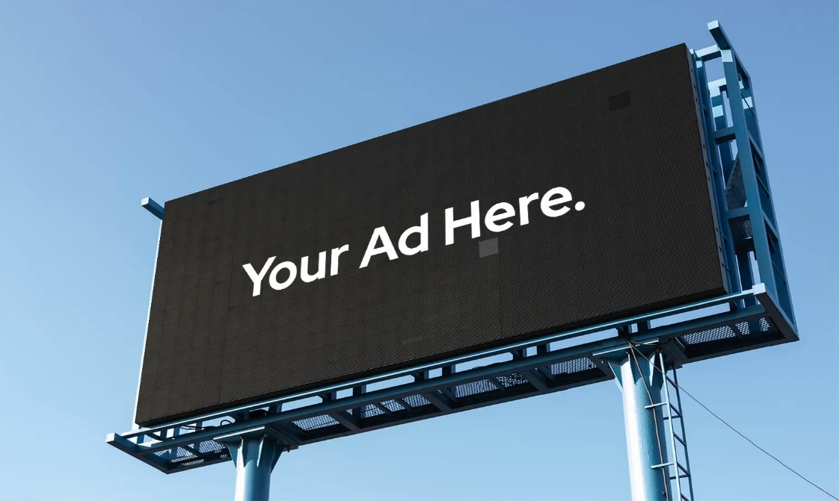

Our Services
Hoarding
Bus Shelter

Slide 7
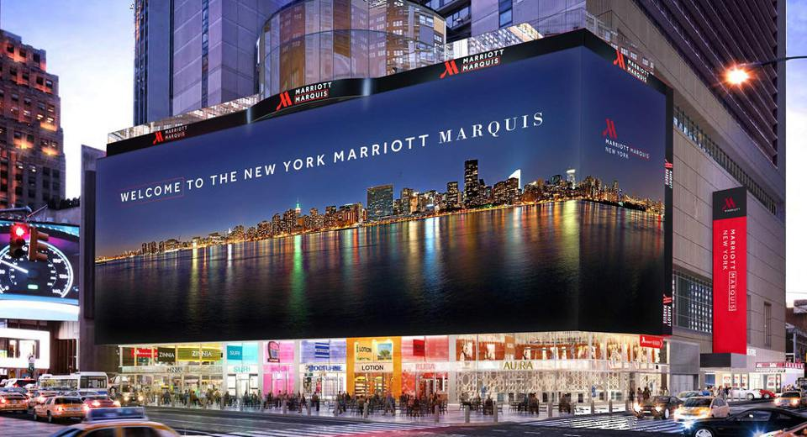
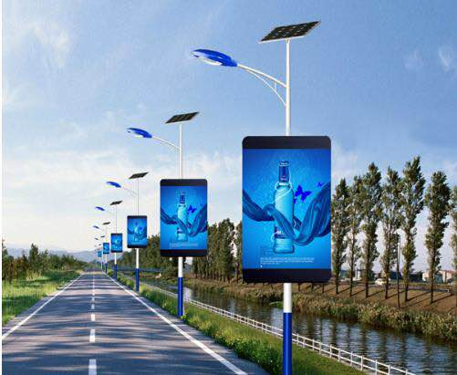
Digital Screen
Branding
Digital Steamers
Vehicle Branding

Slide 8
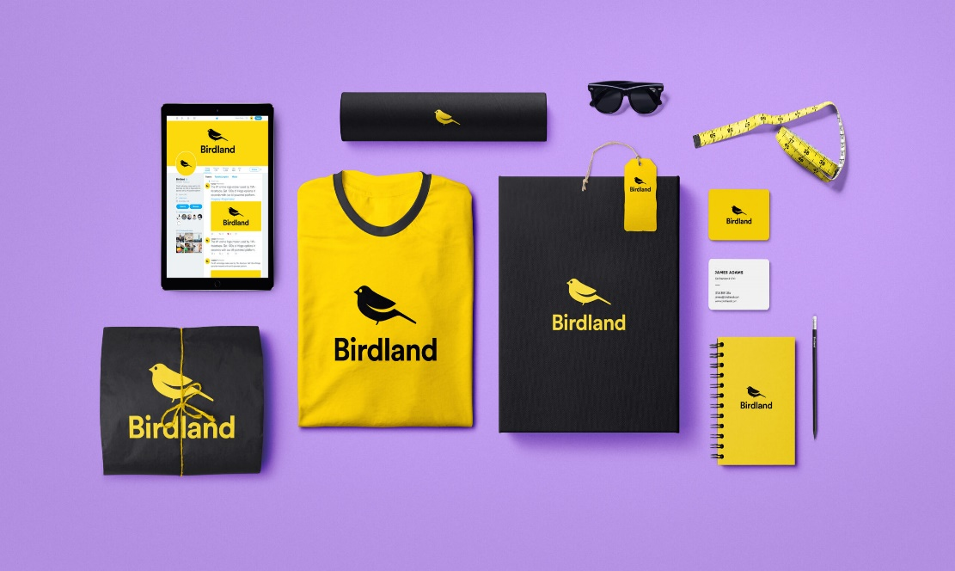
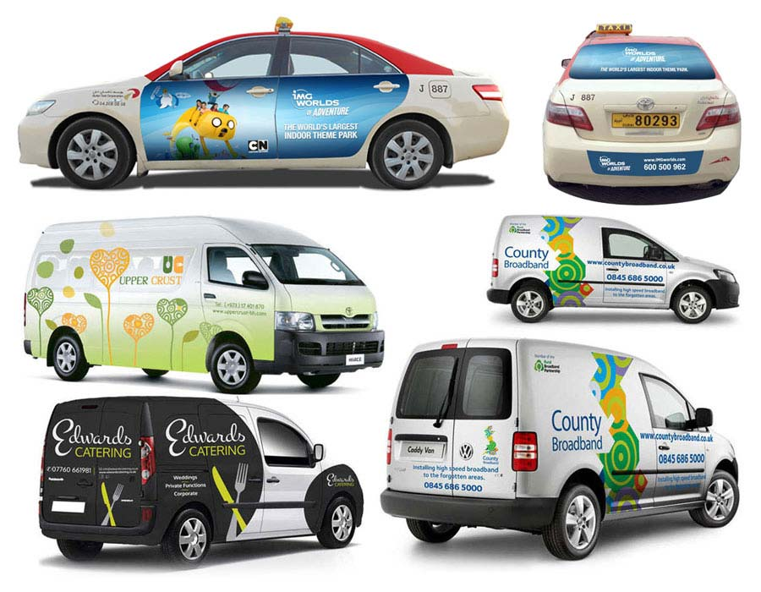
Branding
Vehicle Branding

Slide 9
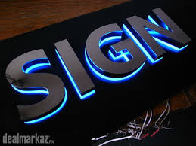
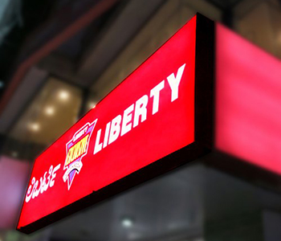
3D Board
Backlit Board

Slide 10

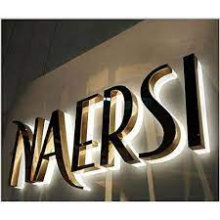
Front lit Board
3D work

Slide 11
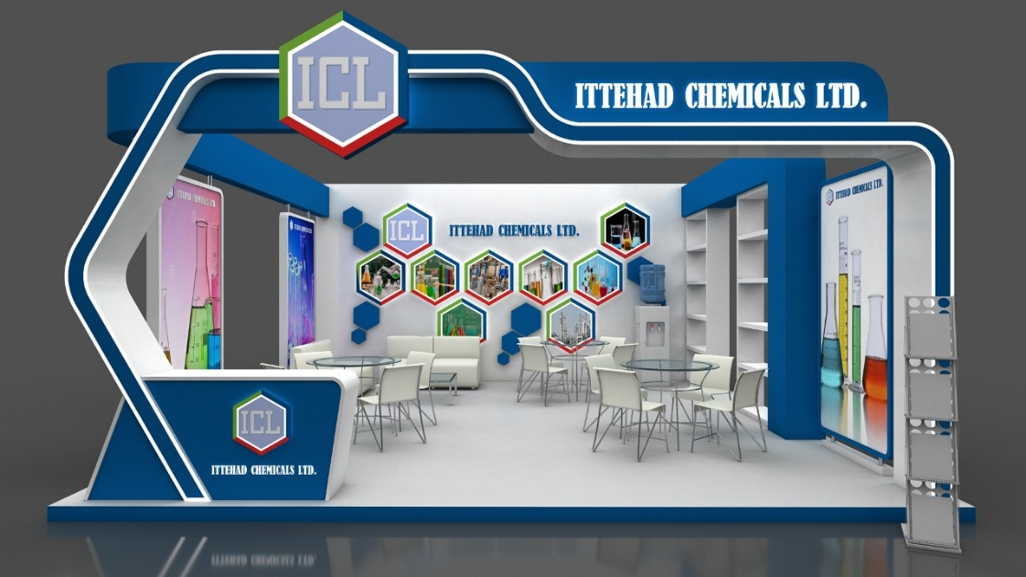
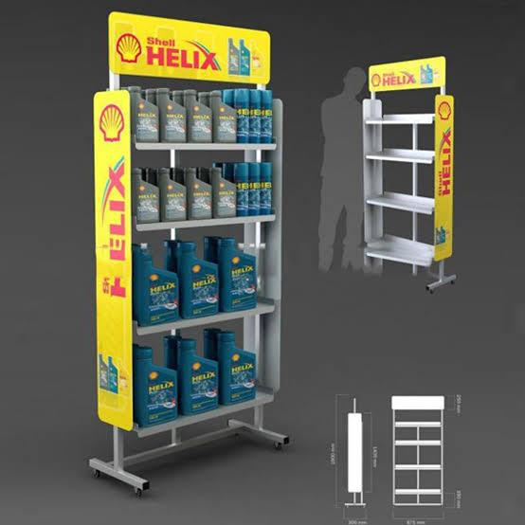
Exhibition Stall
Racks

Slide 12
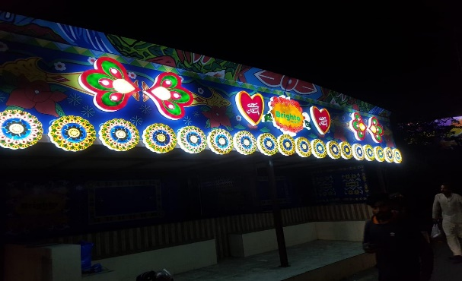
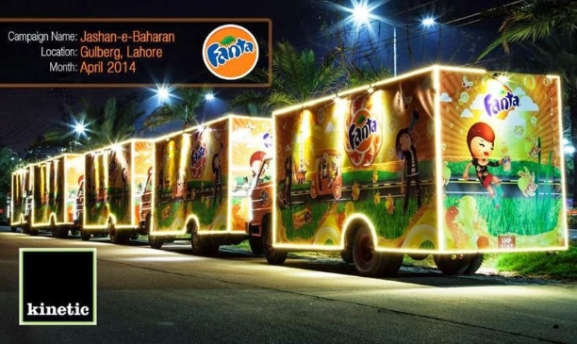
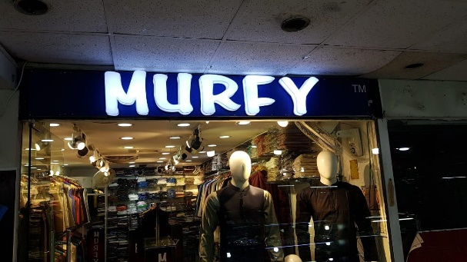
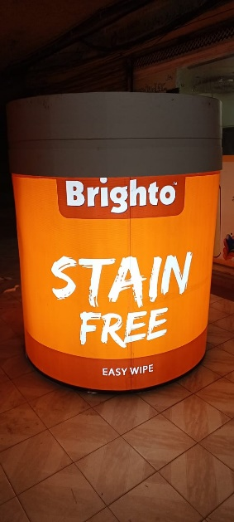
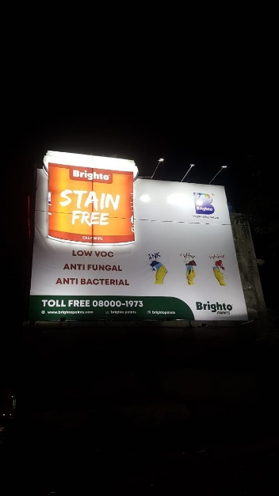
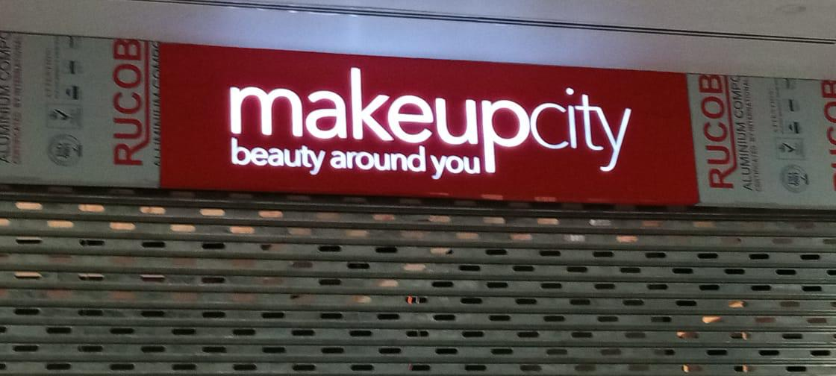
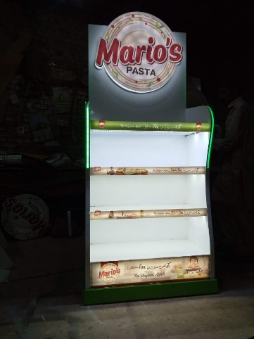
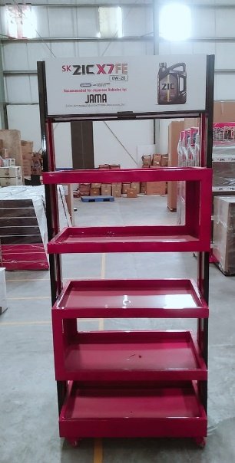
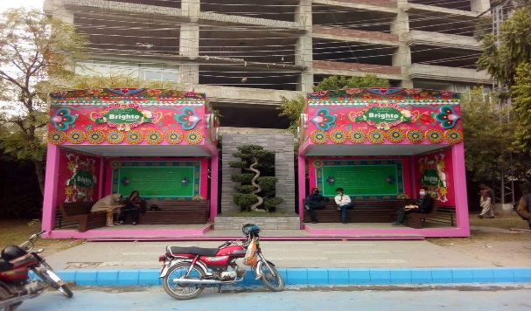
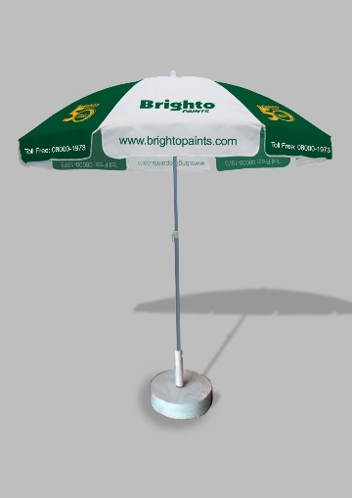
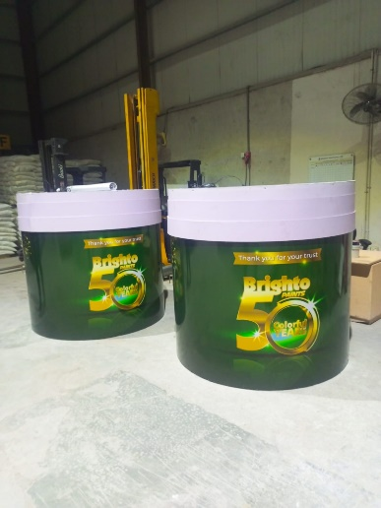
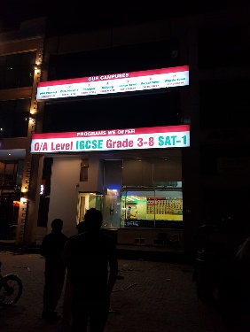
Our Work

Slide 13
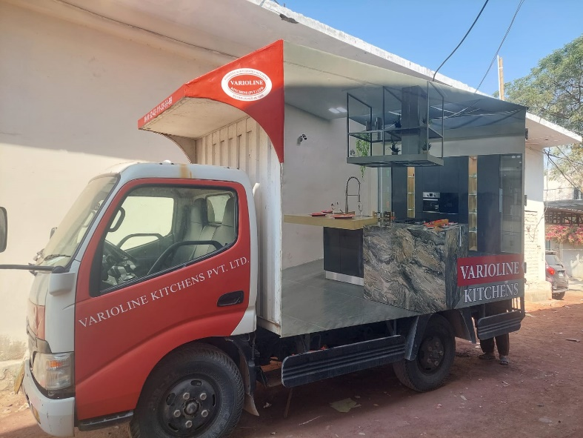
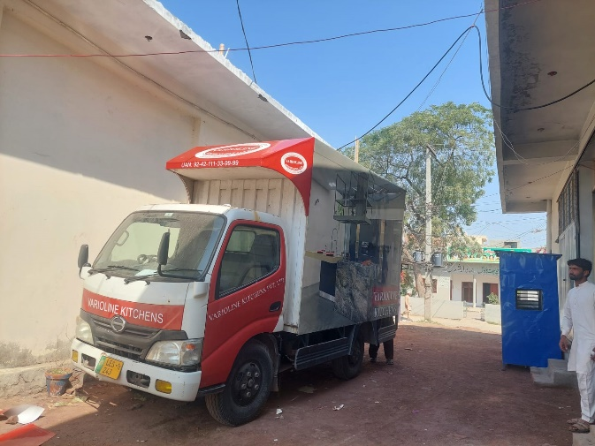
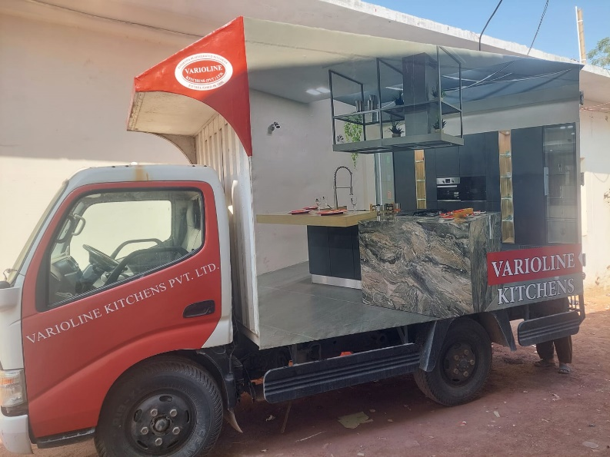
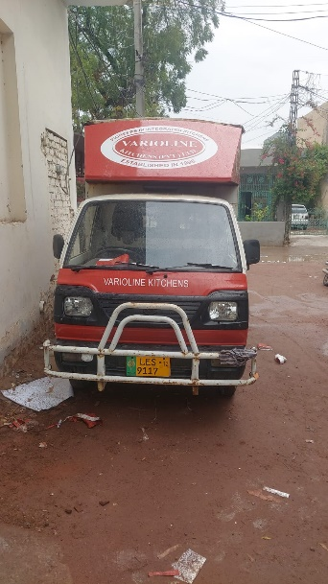
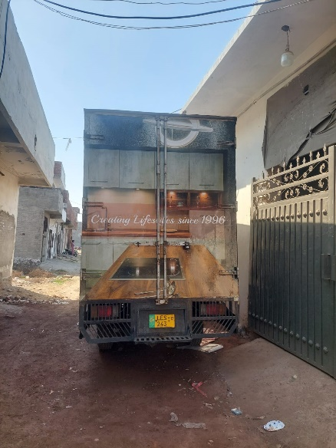
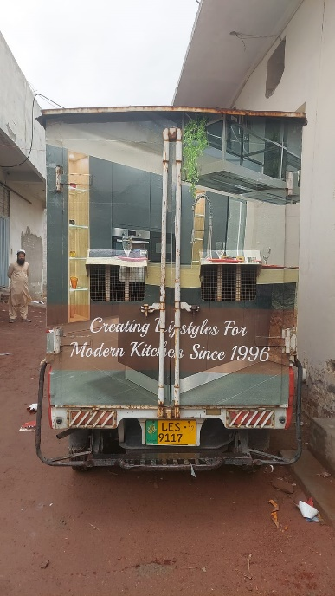
Our Work

Slide 14


Contact Us
anas.adsumpak@gmail.com
0324-4252790
Address: Office# 10-F First Floor Hajvery tower Chowk Chuburji, Lahore

